Slide 1
M354 Lighthouse
RFQ V02
2024-12-2

Slide 2
Revision History
Date | Version No. | Description | Engineer | Checked By | Remark
2024-11-21 | 01 | Initial RFQ | Tony Zhao | Tony Chen
2024-11-21 | 02 | Delete M354-06-01-Conductive sponge from Bom and assembly process; 2. Bom has been changed. 3. E BOM of front module has been updated. 4. Update assembly process. | NANNAN.H | Tony Chen
2025-02-05 | 03 | Light pipe carrier & RH/LH light pipe structure change; Screw 1 & Screw for heatsink changed; Foam seal/Bottom enclosure/Shield for RGB PCBA/TCU Heatsink/Grounding Sheetmetal structure change; | Tony Zhao | Tony Chen

Slide 3
Initial BOM
Part no. | Customer PN | Part name | Source | Material/Spec./Size. | Unit | Usage | Remarks
M354-01 | 2087072-03-B | Light pipe carrier | B | Black PC, Material: Covestro Makrolon 2805 | PCS | 1 | change the 3d data
M354-02 | 2087072-02-B | Right light pipe | B | Transparent PC, Material: Covestro Makrolon 2805 | PCS | 1 | 3D structure change
M354-03 | 2087072-01-B | Left light pipe | B | Transparent PC, Material: Covestro Makrolon 2805 | PCS | 1 | 3D structure change
M354-04 | 2056109-00-A | Product label | B | Fasson 72825T, 50*24mm | PCS | 1 | Refer to C-D540-04-000-95
M354-05 | 2075230-00-A | Screw 1 | B | BLT,PN,M2x5,STL,G0109[B] | PCS | 3 | Screw dimension change
M354-06 | 2063153-00-A | Lighthouse microphones ASY | P | PCBA + Acoustic mesh | PCS | 1 | delete M354-06-01-Conductive sponge
M354-06-02 | 2007839-10-A | Lighthouse microphones' PCBA | P | PCB + E-components + Connector | PCS | 1
M354-06-02-01 | 2007839-00-A | Lighthouse microphones' PCB | B | FR-4, 207*70*1.6mm | PCS | 1
M354-06-02-02 | 2154655-00-A | BLE stamping antenna | B | SPCC, 1/2H; T=0.6mm; Pre-Ni Plating 3-5um | PCS | 1
M354-06-02-03 | 2136899-00-A | Shield 1 | B | Nickel Silver C7701, T=0.25mm | PCS | 1
M354-06-02-04 | 2154658-00-A | Shield 2 | B | Nickel Silver C7701, T=0.2mm | PCS | 1
M354-06-02-05 | 2154657-00-A | Shield 3 | B | Nickel Silver C7701, T=0.2mm | PCS | 1 | change the 3d data
M354-06-02-06 | 2157664-00-A | Shield cover 1 |  | Nickel Silver C7701, T=0.2mm | PCS | 1 | new
08-0085X000 | 1784146-00-A | Receptacle Connector | B | Hirose, KMS-560A(800) | PCS | 1
08-0128X000 | 2144255-00-A | Hirose 44pin connector | B | Hirose, FX23-40S-0.5SV10 | PCS | 1
08-0129X000 | 2121500-00-A | 4pin, Vertical SMD connector | B | KYOCERA AVX: 009159004551906 | PCS | 2 | change to SAA part no.
SO-PA-37 | N/A | Indium10.8 HF | B | Sn96.5Ag3.0Cu0.5 | G | 1
M354-06-04 | 2157741-00-A | Acoustic mesh | B | Foam + adhesive + Acoustic mesh | PCS | 8
M354-07 | 1643719-00-A | Screw 2 | B | ST4X12-(1.46) Screw | PCS | 8 | Refer to N-G325-04-003-85
M354-08 | 2123618-00-A | Lighthouse maplight module | P | Foam + Housing Asy + PCBA + Screw | PCS | 1
M354-08-01 | 2136903-00-A | Foam seal, Inlet | B | Rogers PORON 4790-15375-04 + 3M 9495LE | PCS | 1 | Foam outline change
M354-08-02 | N/A | Lighthouse maplight Housing-ASY | B | Housing + PCBA + Screw 3 | PCS | 1
M354-08-02-01 | 2123618-02-A | Lighthouse maplight Housing | O | PC | PCS | 1
M354-08-02-02 | 2134814-01-A | Lighthouse maplight PCBA | O | PCB + E-components + Shield frame | PCS | 1
M354-08-02-02-01 | 2134814-00-A | Lighthouse maplight PCB | O | FR-4, 143*45*1.6mm | PCS | 1
M354-08-02-02-02 | 2157663-00-A | Lighthouse maplight shiled frame | O | Nickel Silver C7701, T=0.2mm | PCS | 1
SO-PA-37 | N/A | Indium10.8 HF | O | Sn96.5Ag3.0Cu0.5 | G | 1
M354-08-04 | 1809323-00-A | Screw 3 | O | PTFS,PF,20x9,STL,G0109.1 | PCS | 3
M354-09 | 2063151-00-A | Lighthouse front module, Bottom enclosure ASY | P | Screw 1 + Fan + Bottom enclosure | PCS | 1
M354-05 | 2075230-00-A | Screw 1 | B | BLT,PN,M2x5,STL,G0109[B] | PCS | 3
M354-09-01 | 2008907-00-A | Fan | B | Multimaterial | PCS | 1 | Refer to N-G629-04-T00-96
M354-09-02 | 2063152-00-A | Bottom enclosure | B | Plastic cover: PC+ABS, Sabic Cycoloy C1200HF Compression limiter: S10C (1008) Metal insert: Brass, with M2*3 Screw hole | PCS | 1 | 3D structure change
M354-10 | 2063149-00-A | Lighthouse front module, PCBA ASY | P | Multimaterial | PCS | 1
M354-10-01 | 2157162-00-A | Screw for heatsink (ICR & TCU) | B | M3X0.5-6g screw | PCS | 10 | Screw type change
M354-10-02 | 1616631-10-N | Radar PCBA | P | ICR PCB + E-Components | PCS | 1 | Refer to N-G737-04-T00-75
M354-10-02-01 | 1616631-00-N | Radar PCB | B | ICR PCB, FR-4, 45*50*1.6mm | PCS | 1 | Refer to N-G737-04-000-74
SO-PA-37 | N/A | Indium10.8 HF | B | Sn96.5Ag3.0Cu0.5 | G | 1
M354-10-03 | 1619330-00-D 2136902-00-A 2136901-00-A 2157660-00-A | Thermally conductive silicone | B | Lord CoolTherm SC-1600 | G | 10 | Refer GA-GL-172
M354-10-04 | 2063159-00-B | ICR Heatsink | B | A304, SURTEC 650 | PCS | 1
M354-10-05 | 2063163-00-A | Shield for RGB PCBA | B | SUS 301 | PCS | 2 | 3D structure change
M354-10-06 | 2091685-01-A | RGB PCBA | B | RGB PCB + E-Components | PCS | 2 | Provided by another supplier
M354-10-06-01 | 2091685-00-A | RGB PCB | O | 76*22*1.6mm, FR-4 | PCS | 2
M354-10-07 | 2063157-00-B | TCU Heatsink | B | A304, SURTEC 650 | PCS | 1 | 3D structure change
M354-10-08 | 2087405-01-A | Lighthouse front module PCBA | P | Lighthouse front module PCB + Connector + Shield frame + E-Components | PCS | 1 | change E BOM and gerber file
M354-10-08-PCB | 2087405-00-A | Lighthouse front module PCB | B | EM-827, 329*145*1.6mm. | PCS | 1 | change the gerber file
08-0013A000 | 1501758-00-A | Molex connector | B | Molex LLC 5040500491 | PCS | 1
08-0127X000 | 2101754-00-A | Hirose 40Pin connector | B | Hirose, FX23-40P-0.5SV15 | PCS | 1
08-0100X000 | 2018695-00-A | EBC connector | B | Rosenberger, EBCK111-40MN5 | PCS | 1
08-0122Z000 | 2133470-00-A | Rosenberger H-MTD connector | B | Rosenberger, E6S20D-40MT5-Z | PCS | 1 | change to SAA part no.
08-0133X000 | 2141140-00-A | Hirose 20Pin connector | B | Hirose, FX23-20P-0.5SV20 | PCS | 1 | change the connector type.
08-0085X000 | 1784146-00-A | Receptacle Connector | B | Hirose, KMS-560A(800) | PCS | 4
08-0125X000 | 2025081-00-A | Samtec 10Pin connector | B | TSM-105-02-L-DV |TSM-105-02-L-DV-TR Samtec | PCS | 1 | change to SAA part no.
09-00000035 | 1949388-00-A | On Board clamp | B | KITAGAWA OGC-224018U | PCS | 12 | change the quantity form 10 to 12
08-0081X000 | 1919021-00-A | Connector | B | Hirose, U.FL-R-SMT-K(800) | PCS | 4
08-0098X000 | 1673815-00-A | C-Grid Connector | B | Molex, 87898-0304 | PCS | 1
08-0125X000 | 1096510-00-A | Type C RA connector | B | Molex, 1054500101 | PCS | 1
08-0084X000 | 1100658-00-A | SIM connector with card detect | B | Yamaichi Electronics FMS006-2340-0-VE | PCS | 1
N-H045-04-000-89 | 2024814-00-A | OHC SHIELD FENCE | B | Laird, 2024814-00-A; Nickel Silver C7701, T=0.3mm | PCS | 3 | change to SAA part no.
M354-10-08-04 | 2148026-00-A | Shield with Spring Fingers | B | Laird, BMI-S-608 |CT-BMI-S-608 | PCS | 1
M354-10-08-05 | 2136894-00-A | Shield frame 1 for GNSS | B | Nickel Silver C7701, T=0.2mm | PCS | 1
M354-10-08-06 | 2136897-00-A | Shield frame 2 for GNSS | B | Nickel Silver C7701, T=0.2mm | PCS | 1
M354-10-08-07 | 2136895-00-A | Shield frame for maplight | B | Nickel Silver C7701, T=0.2mm | PCS | 1
M354-10-08-08 | 2123617-00-A | WiFi Stamping antenna | B | SPCC, 1/2H; T=0.4mm; Pre-Ni Plating 3-5um | PCS | 2
M354-10-08-10 | 2154656-00-A | fan shield | B | Nickel Silver C7701, T=0.2mm | PCS | 1 | new
SO-PA-37 | N/A | Indium10.8 HF | B | Sn96.5Ag3.0Cu0.5 | G | 3
GA-GL-171 | N/A | Surface mount adhesive | B | LOCTITE 3609 | G | 1
N-H045-04-001-89 | 2042355-00-A | OHC SHIELD cover | B | Nickel Silver C7701, T=0.15mm; With dieletric coating | PCS | 3 | change to SAA part no.
M354-10-08-11 | 2157662-00-A | Shield cover 1 for GNSS | B | Nickel Silver C7701, T=0.2mm | PCS | 1 | new
M354-10-08-12 | 2157661-00-A | Shield cover 2 for GNSS | B | Nickel Silver C7701, T=0.2mm | PCS | 1 | new
M354-10-10 | 2063160-00-B | Micro-coax cable | B | Hirose U.FL-LPKT-066 + Ø1.32 Micro cable + GND Clamp | PCS | 2
M354-10-11 | 2171692-00-A | ICR Connector | B | Press-fit pin + Plastic housing | PCS | 1
M354-11 | 2123616-00-A | Rosenberger EBC connector Barrel | B | Rosenberger EBCS10D-S13N1 | PCS | 1
M354-12 | 2060992-00-A | Lighthouse Top module ASY | P | Top cover + GNSS PCBA + Grounding Sheetmetal | PCS | 1
M354-12-01 | 2136896-00-A | Grounding Sheetmetal | B | CR3-140-270-S-GI60/60-E, Zn Plating | PCS | 2 | 3D structure change, Material change
M354-12-02 | 2040885-10-C | GNSS PCBA | P | GNSS PCB + Connector + E-Components | PCS | 1
M354-12-02-01 | 2040885-00-C | GNSS PCB | B | FR-4, Ø100*1.4mm | PCS | 1
M354-05 | 2075230-00-A | Screw 1 | B | BLT,PN,M2x5,STL,G0109[B] | PCS | 3
M354-12-02-02 | 2018721-00-A | Rosenberger EBC connector | B | Rosenberg EBCK11T-40MN5 | PCS | 1
SO-PA-37 | N/A | Indium10.8 HF | B | Sn96.5Ag3.0Cu0.5 | G | 1
M354-12-03 | 2060994-00-A | Top Enclosure | B | PC+ABS, Sabic Cycoloy C1200HF+insert mold | PCS | 1 | change the 3d data

Slide 4
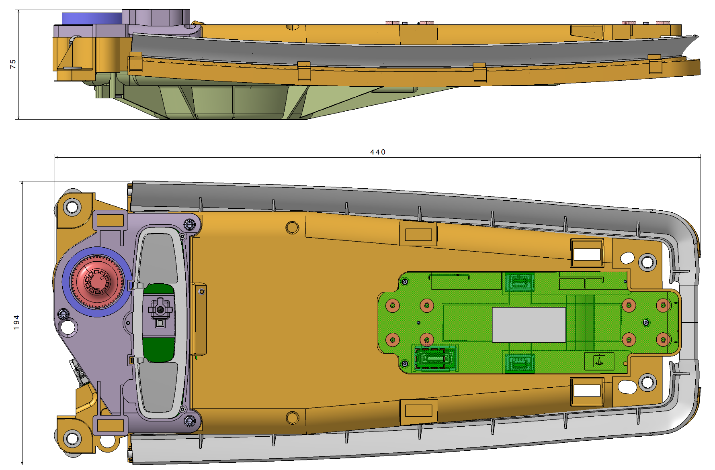
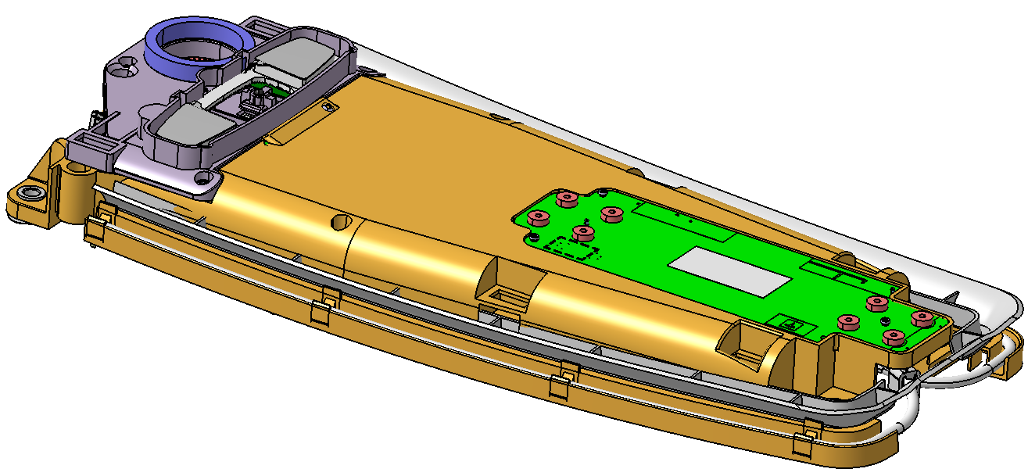
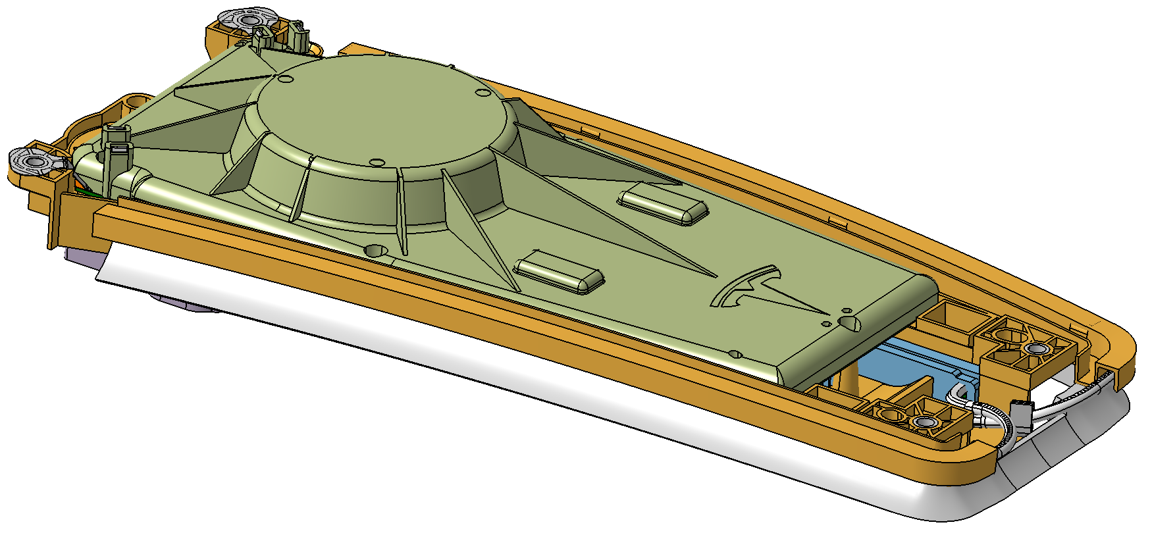
Outline dimension
Outline dimension
Unit: mm

Slide 5
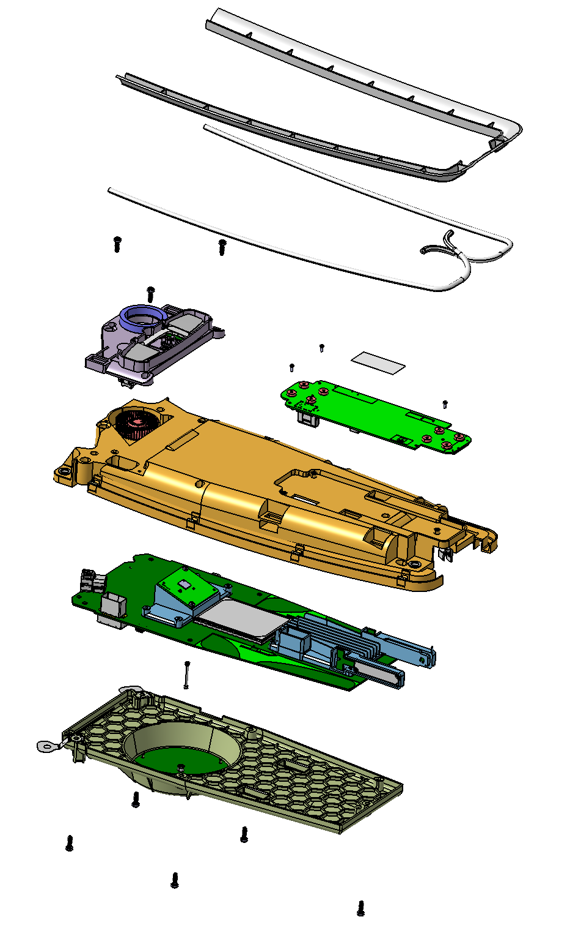
Exploded view—TLA product
M354-01
Light pipe carrier
M354-02
Right light pipe
M354-07
Screw 2
M354-03
Left light pipe
M354-08
Map-light module
M354-03
Left light pipe
M354-04
Product label
M354-09
Lighthouse front module, Bottom enclosure ASY
M354-05
Screw 1
M354-06
Microphones module
M354-10
Lighthouse front module, PCBA ASY
M354-11
Rosenberger EBC connector Barrel
M354-12
Lighthouse Top module ASY

Slide 6
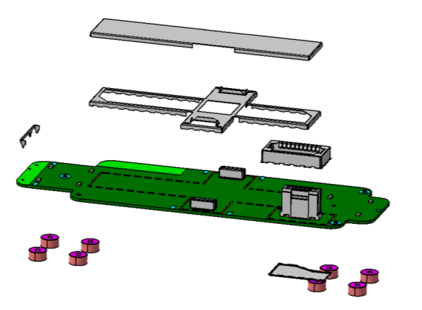
Exploded view—M354-06 Microphones module
M354-06-02-06
Shield cover 1
M354-06-02-03
Shield 1
M354-06-02-02
BLE stamping antenna
M354-06-02-04
Shield 2
M354-06-02
Lighthouse microphones' PCBA
M354-06-02-01
Lighthouse microphones' PCB
M354-06-02-05
Shield 3
M354-06-04
Acoustic mesh

Slide 7
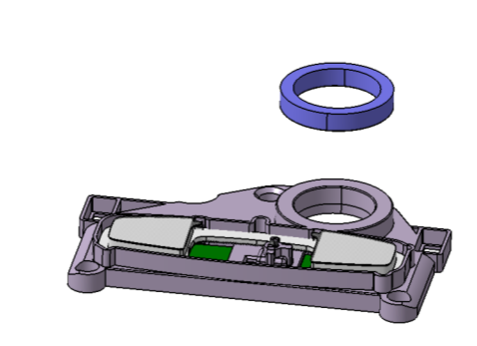
Exploded view—M354-08 Lighthouse map-light module
M354-08-01
FOAM SEAL, INLET
M354-08-02
Lighthouse maplight Housing-ASY

Slide 8
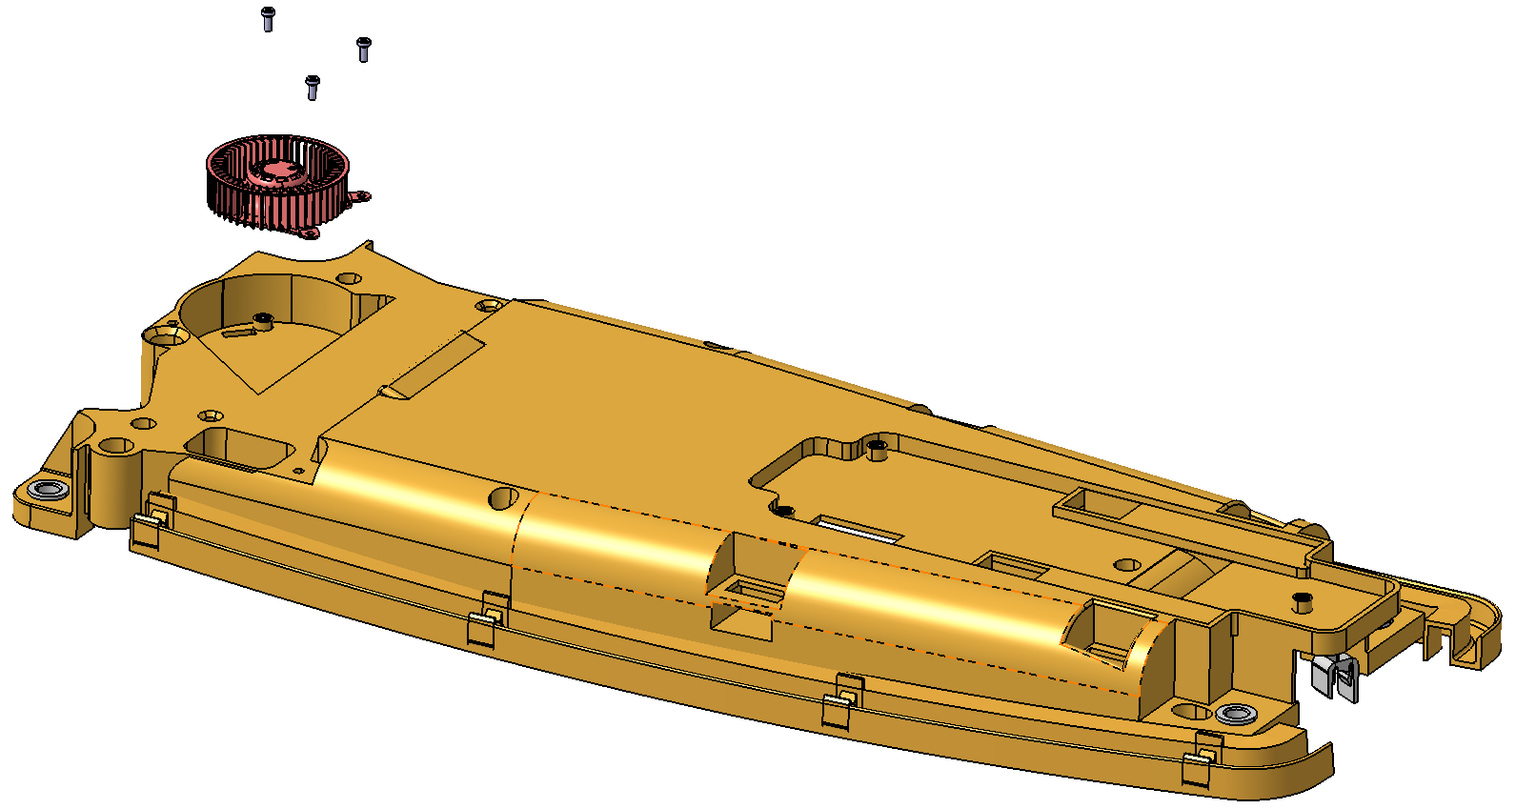
Exploded view—M354-09 Lighthouse front module, Bottom enclosure ASY
M354-05
Screw 1
M354-09-01
Fan
M354-09-02 Bottom enclosure

Slide 9
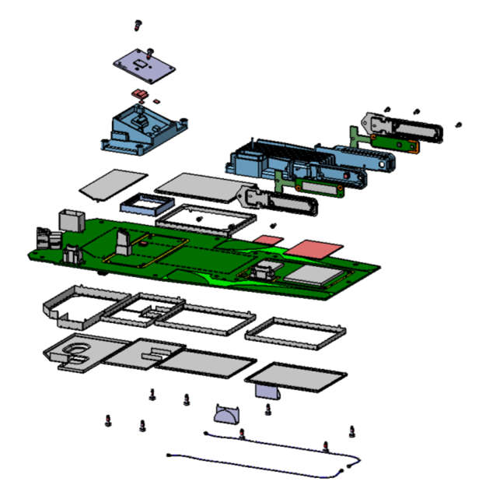
Exploded view—M354-10 Lighthouse front module, PCBA ASY
M354-10-01
Screw 1
M354-05
Screw 1
M354-10-02
ICR PCBA
M354-10-08-04 Shield with Spring Fingers
M354-10-05
Shield for RGB PCBA
M354-10-03
Thermally conductive silicone
M354-10-06
RGB PCBA
M354-10-04
ICR Heatsink
M354-10-07
TCU Heat sink
M354-10-08-10
fan shield
M354-10-08-07Shield frame for maplight
M354-10-08
Lighthouse front module PCBA
M354-10-11
ICR Connector
N-H045-04-000-89
OHC SHIELD FENCE
M354-10-08-05
Shield frame 1 for GNSS
N-H045-04-001-89
OHC SHIELD cover
M354-10-08-06
Shield frame 2 for GNSS
M354-10-08-08WiFi Stamping antenna
M354-10-08-11
Shield Shield cover 1 for GNSS
M354-10-08-12
Shield cover 2 for GNSS

Slide 10
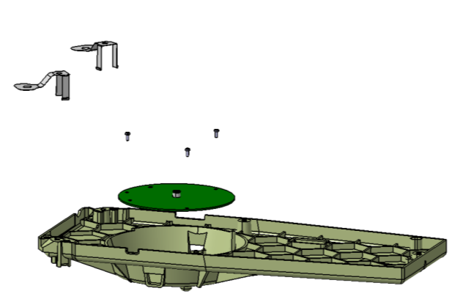
Exploded view—M354-12 Lighthouse Top module ASY
M354-12-01
Grounding Sheet-metal
M354-12-02
GNSS PCBA
M354-12-02
GNSS PCBA
M354-12-03
Top enclosure

Slide 11
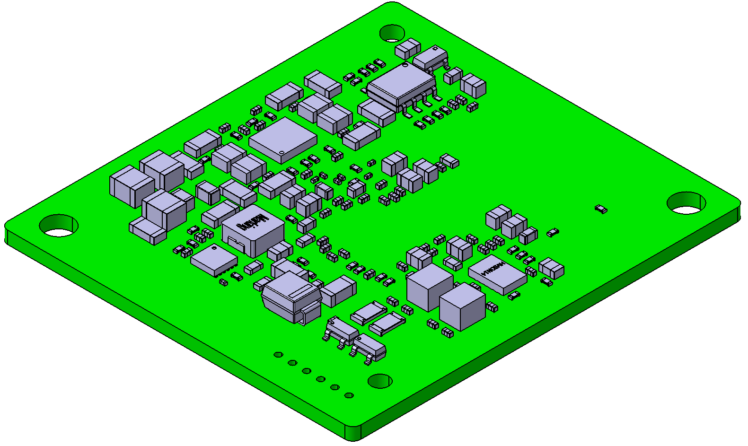
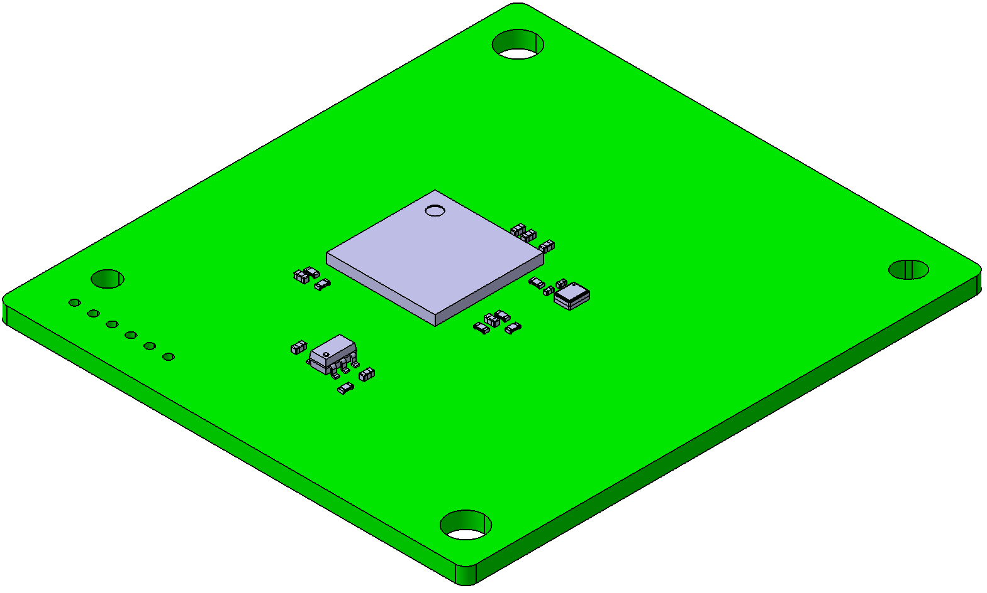
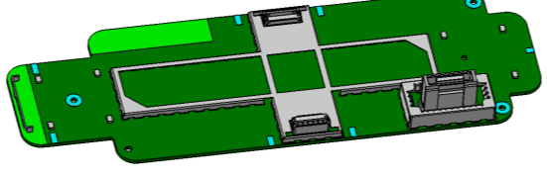
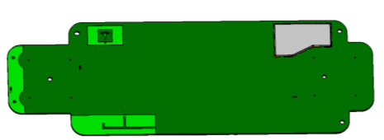
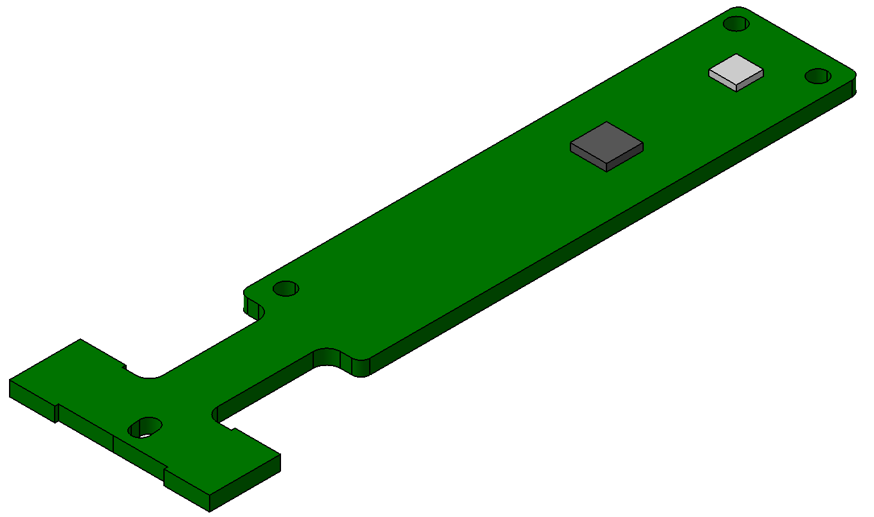
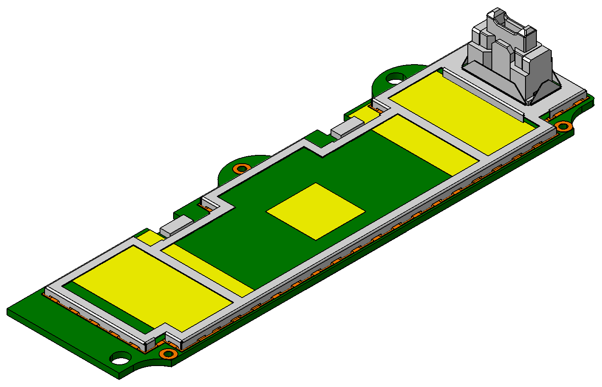
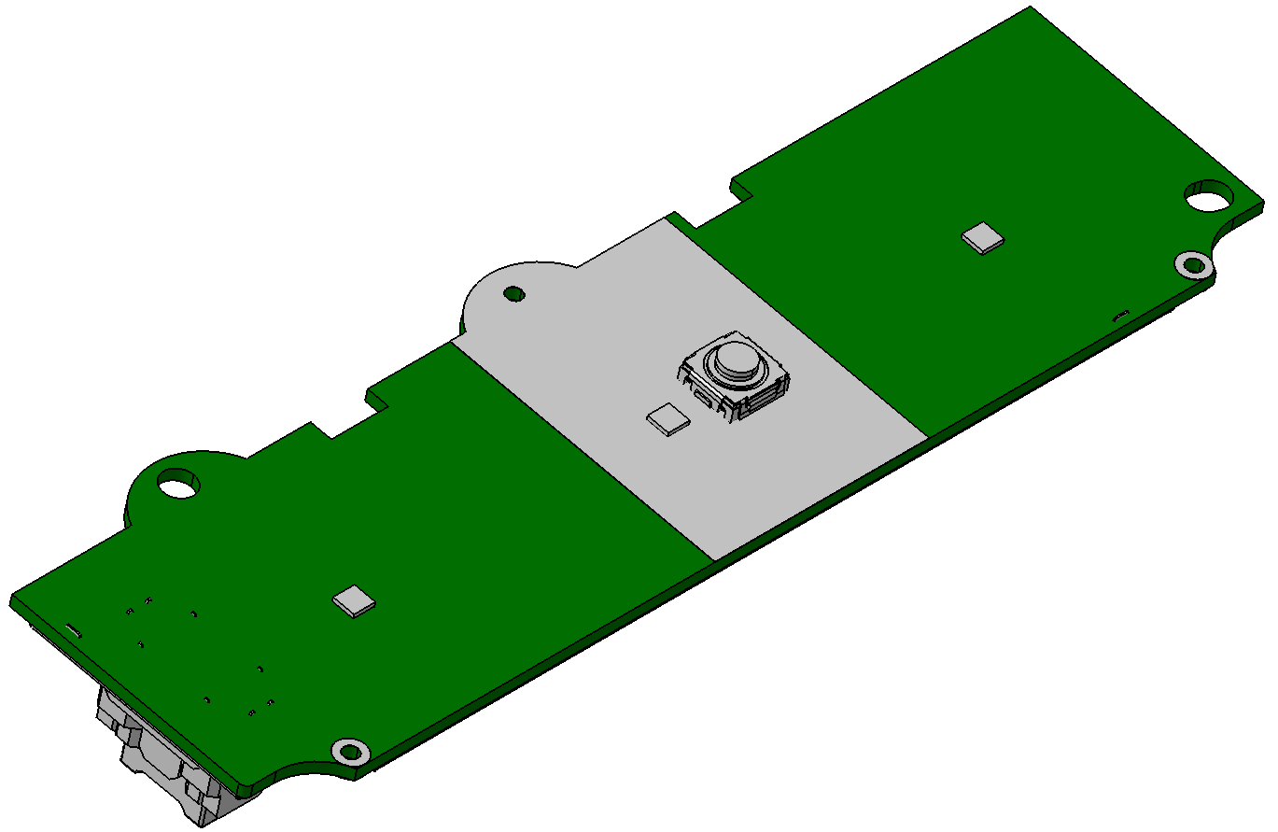
Process flow
PCBA SMT
Total 6 Modules’ PCBA
ICR PCBA
ICT/Flash/FCT test
Lighthouse microphones‘ PCBA.(1 BLE antenna&3 shields)
ICT test
RGB PCBA
Confirmed with customer this PCBA will provided by another supplier
Lighthouse map-light PCBA
Confirmed with customer this PCBA will provided by another supplier

Slide 12
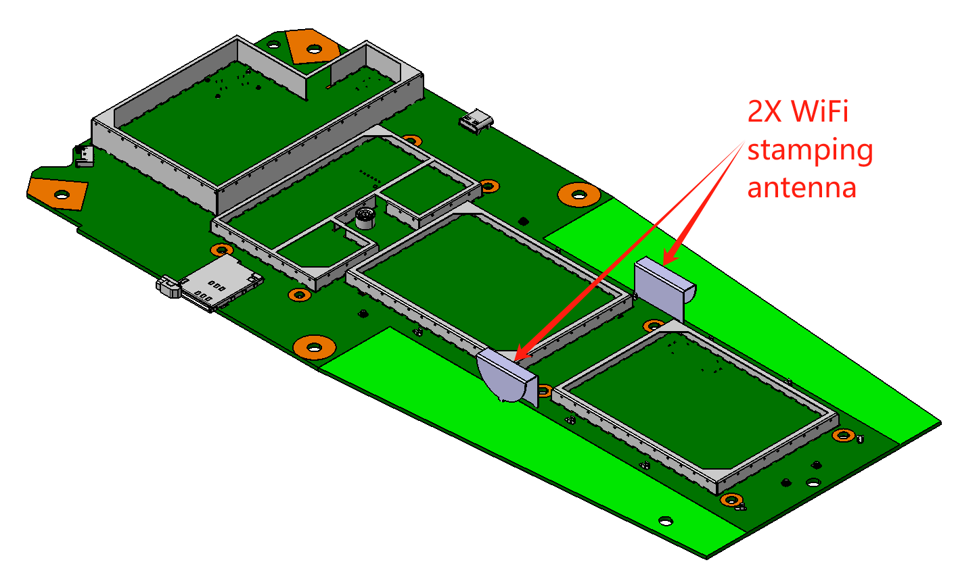
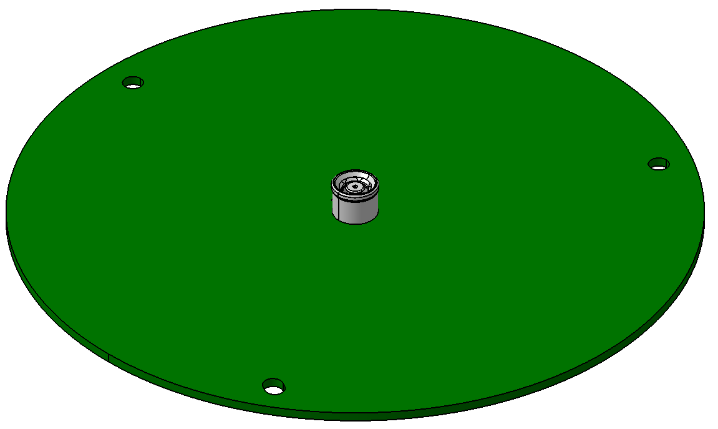
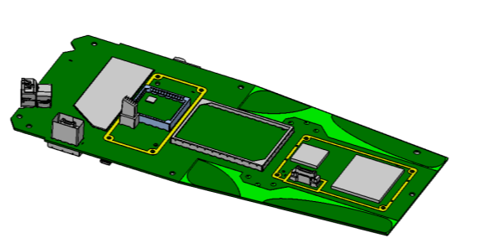
Process flow
PCBA SMT
Total 6 Modules’ PCBA
Lighthouse front module PCBA
ICT/Flash/FCT test
GNSS PCBA
ICT test

Slide 13
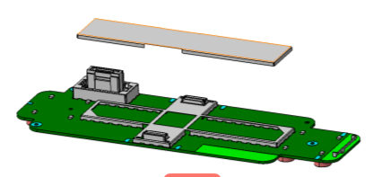
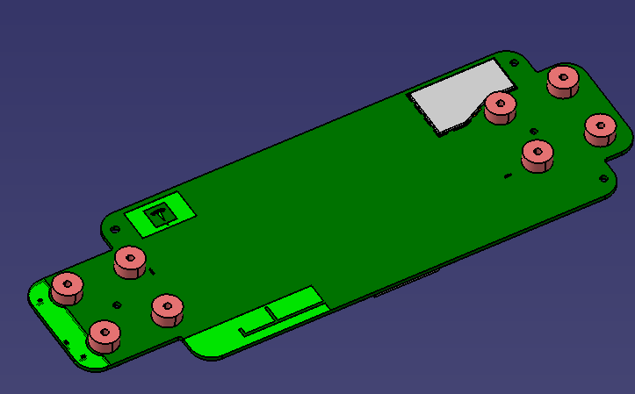
Process flow
Semi module assembly
M354-06 Microphones module Assembly
Pasting acoustic mesh with PCBA
Mounting shield cover with shield frame
M354-08 Lighthouse map-light module
Confirmed with customer the map-light module will be provided by another supplier, SAA just pasting the foam with map-light enclosure.
M354-09 Lighthouse front module, Bottom enclosure ASY
Mounting fan with bottom enclosure by 3 screw.

Slide 14
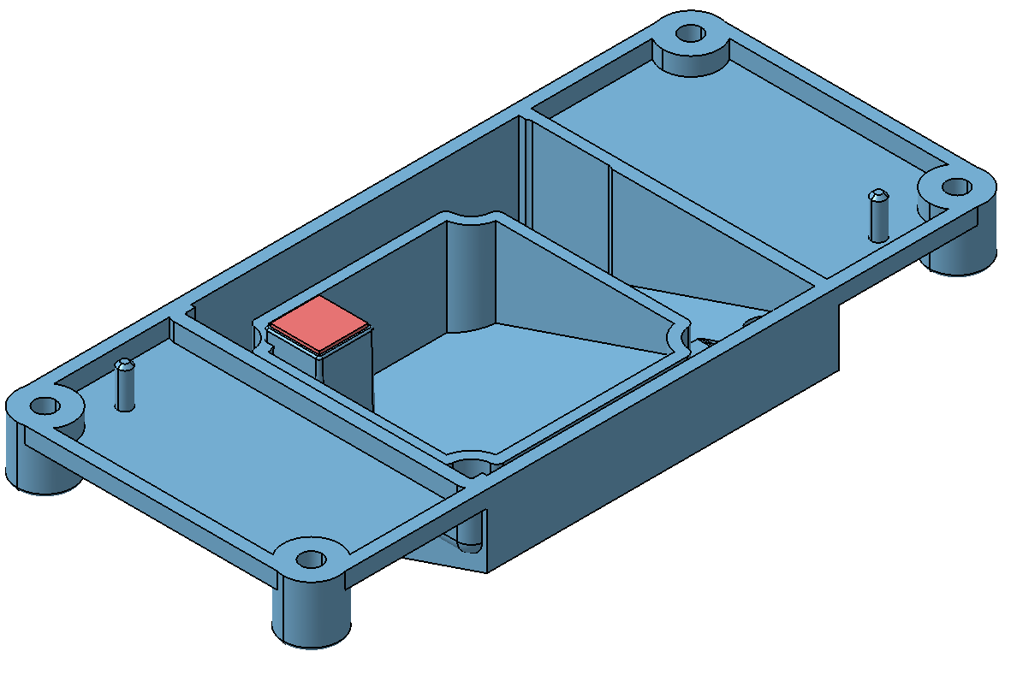
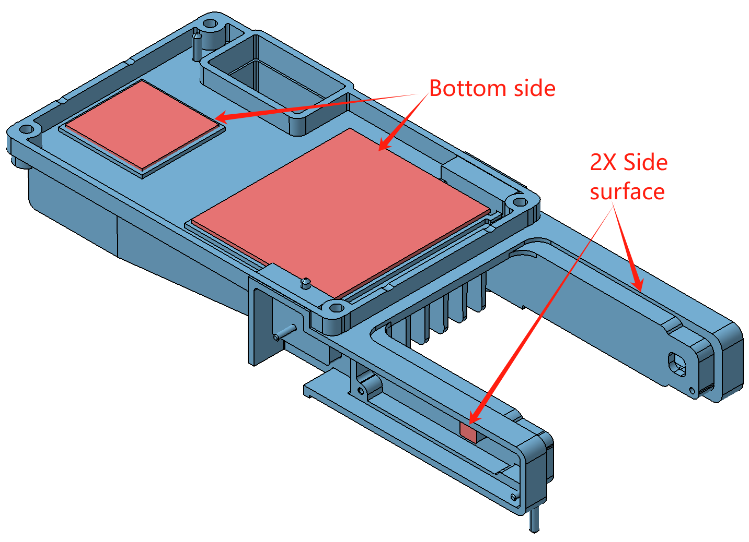
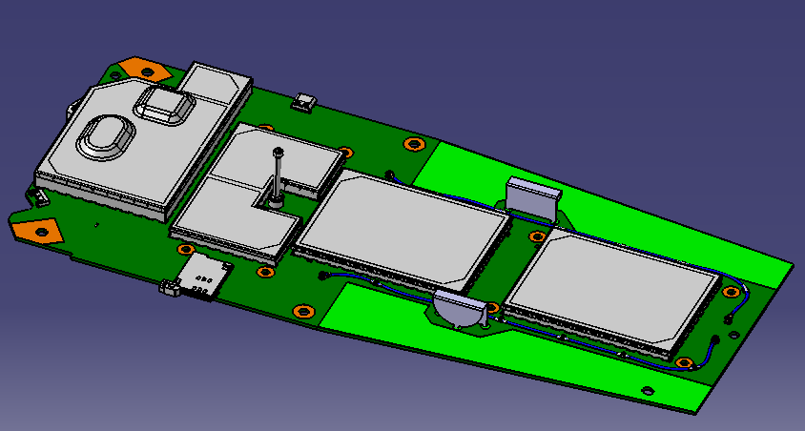
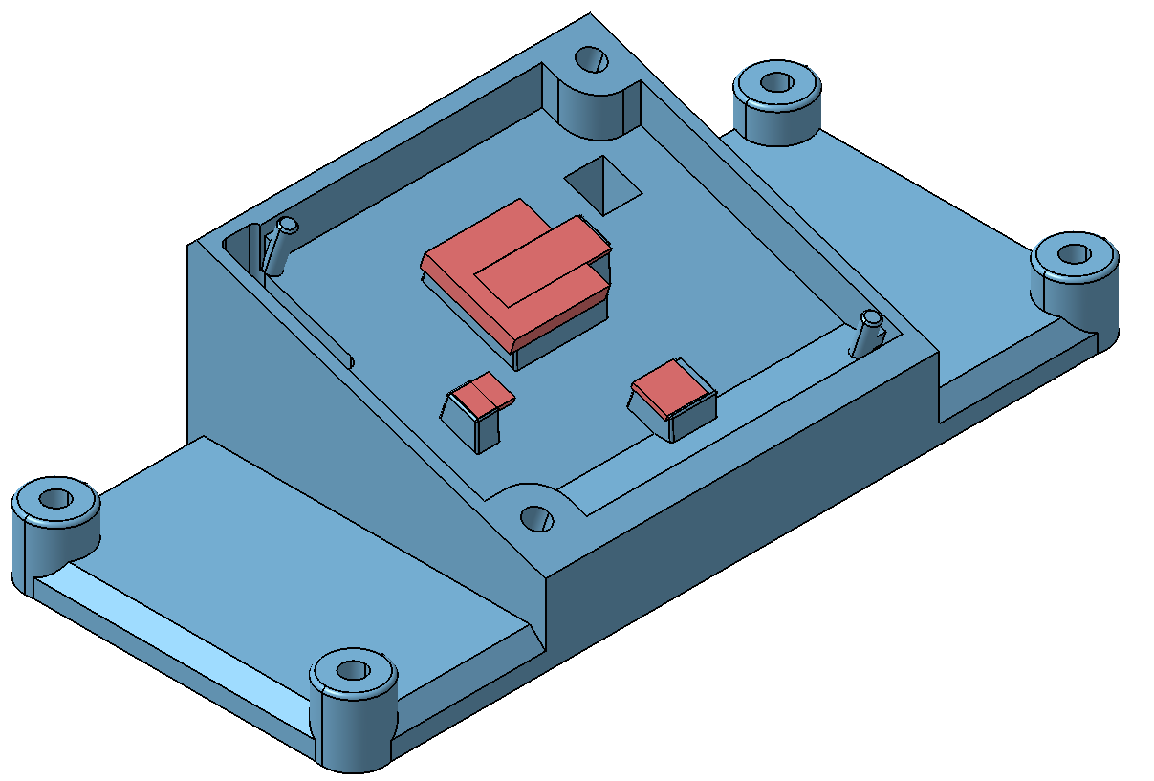
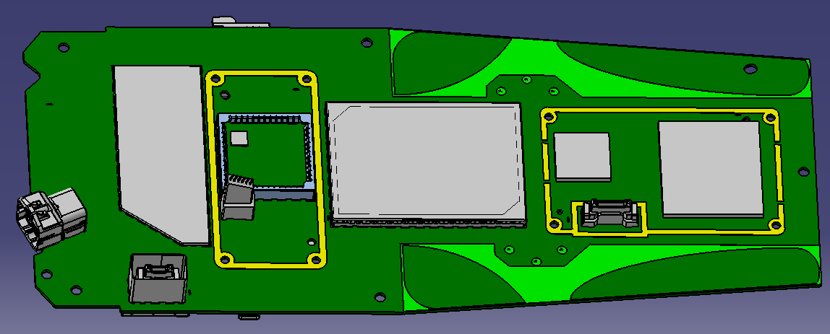
Process flow
3.1 Semi module assembly
Lighthouse front module, Semi-PCBA
Mounting shield cover with shield frame with PCBA (Top & bottom side);
Mounting 2X micro-coax cable with PCBA, 5 GND clamps/cable (Same to TCU 5G);
Mounting the ICR connector with PCBA (Press-fit pin).
ICR heat sink & TCU heat sink Tim dispensing
Dispensing Tim on Top & Bottom side of ICR heatsink;
Dispensing Tim on 2X side surface & Bottom side of TCU heatsink.
ICR CONNECTOR

Slide 15
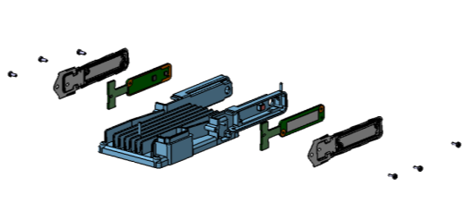
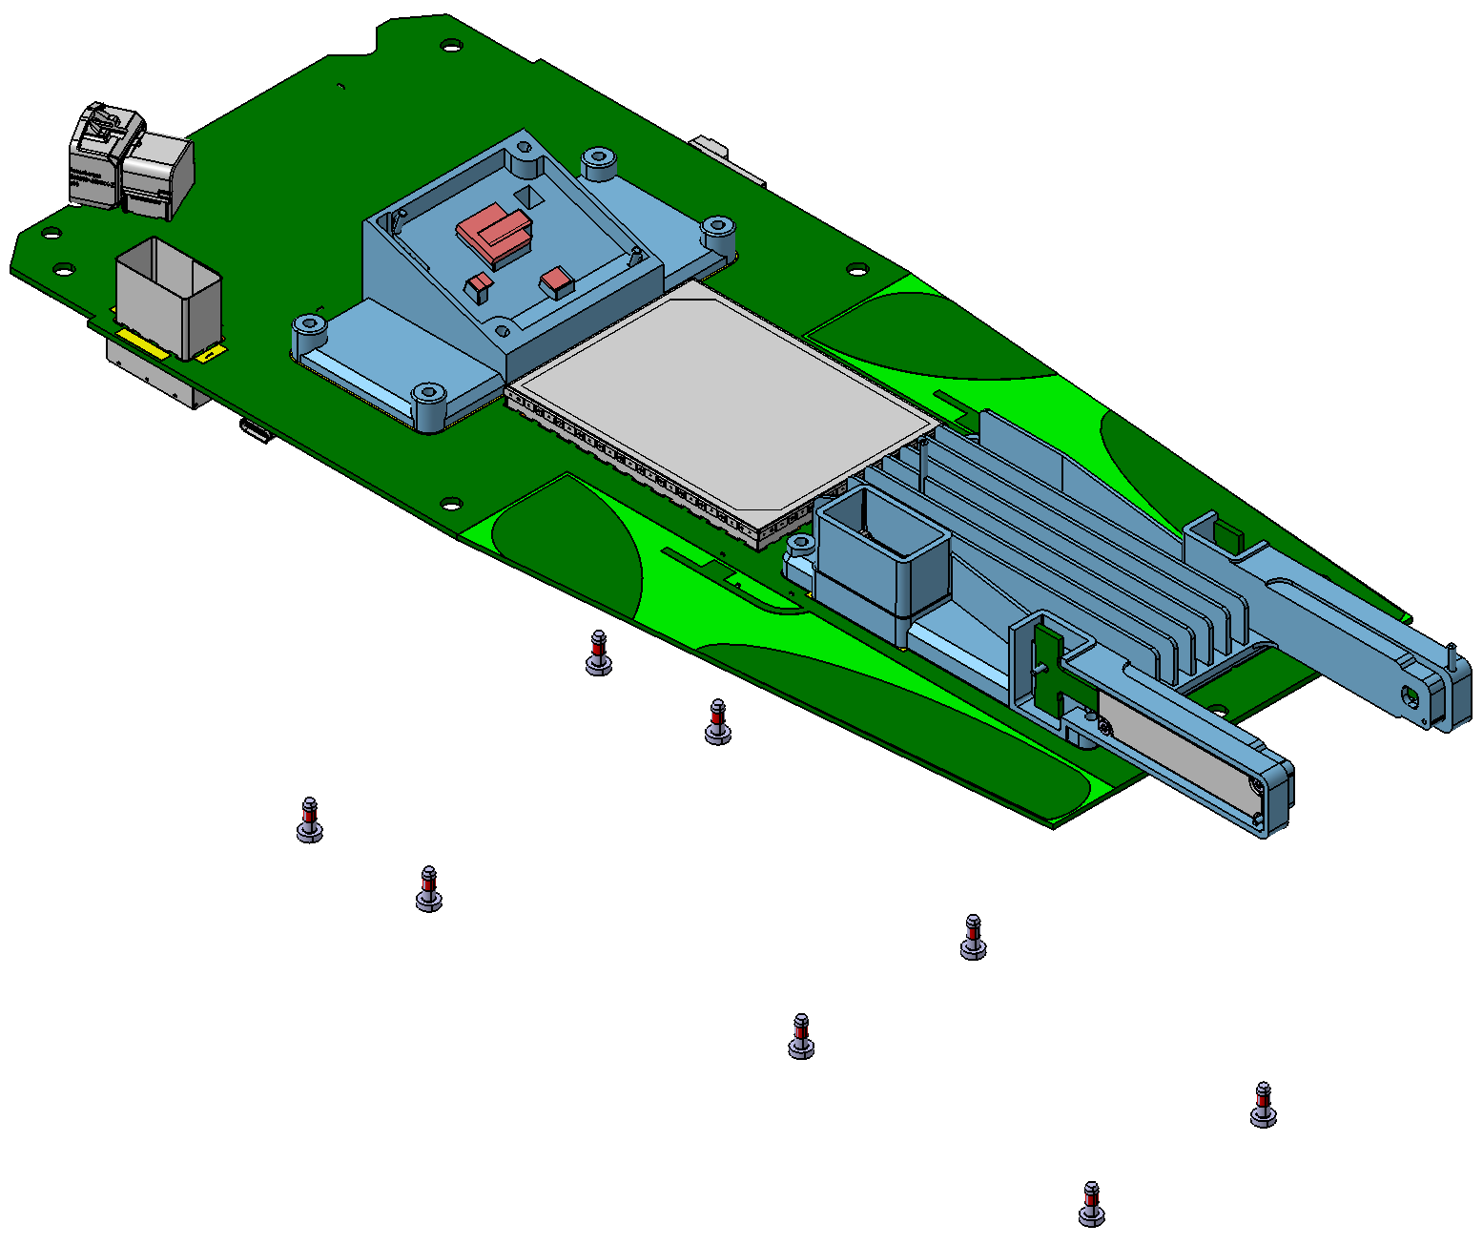
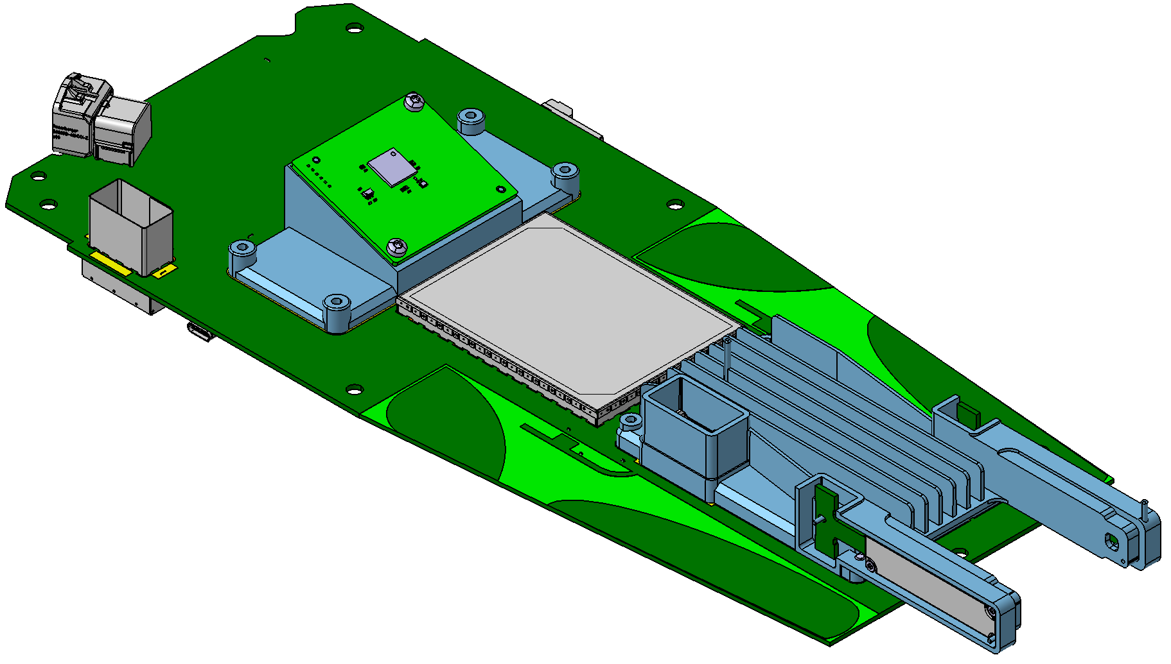
Process flow
3.2 Semi module assembly
Semi-TCU Heatsink ASY
Mounting 2X RGB PCBA & Shield for RGB PCBA with TCU Heatsink by 6 Screws.
M354-10 Lighthouse front module, PCBA ASY
Mounting Semi-ICR heatsink ASY & TCU Heatsink ASY with Lighthouse front module, Semi-PCBA by 8 Screw;
Mounting ICR PCB with ICR heatsink & ICR connector (pay attention to the mounting angel); then fixed the ICR PCBA with ICR heatsink by 2X screw.
M354-10-05
Shield for RGB PCBA
M354-10-07
TCU Heat sink
M354-05
Screw 1
M354-10-06
RGB PCBA

Slide 16
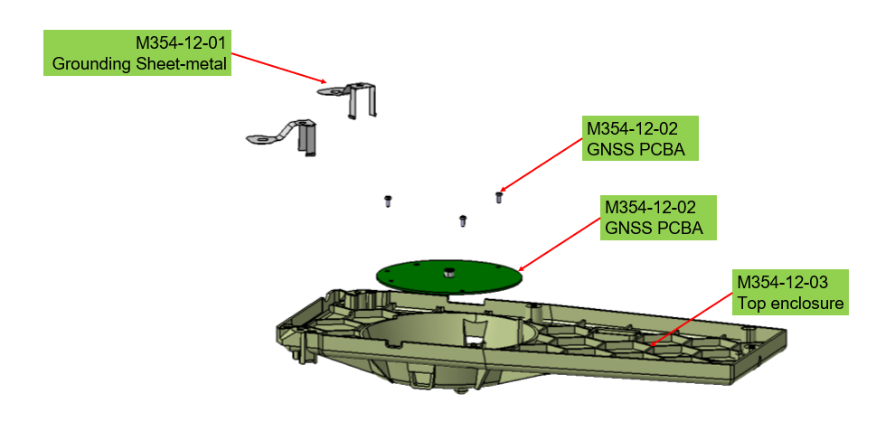
Process flow
4. Lighthouse Top module ASY
Mounting 2X Grounding sheet-metal with Top enclosure;
Mounting GNSS PCBA with top enclosure by 3 screws.

Slide 17
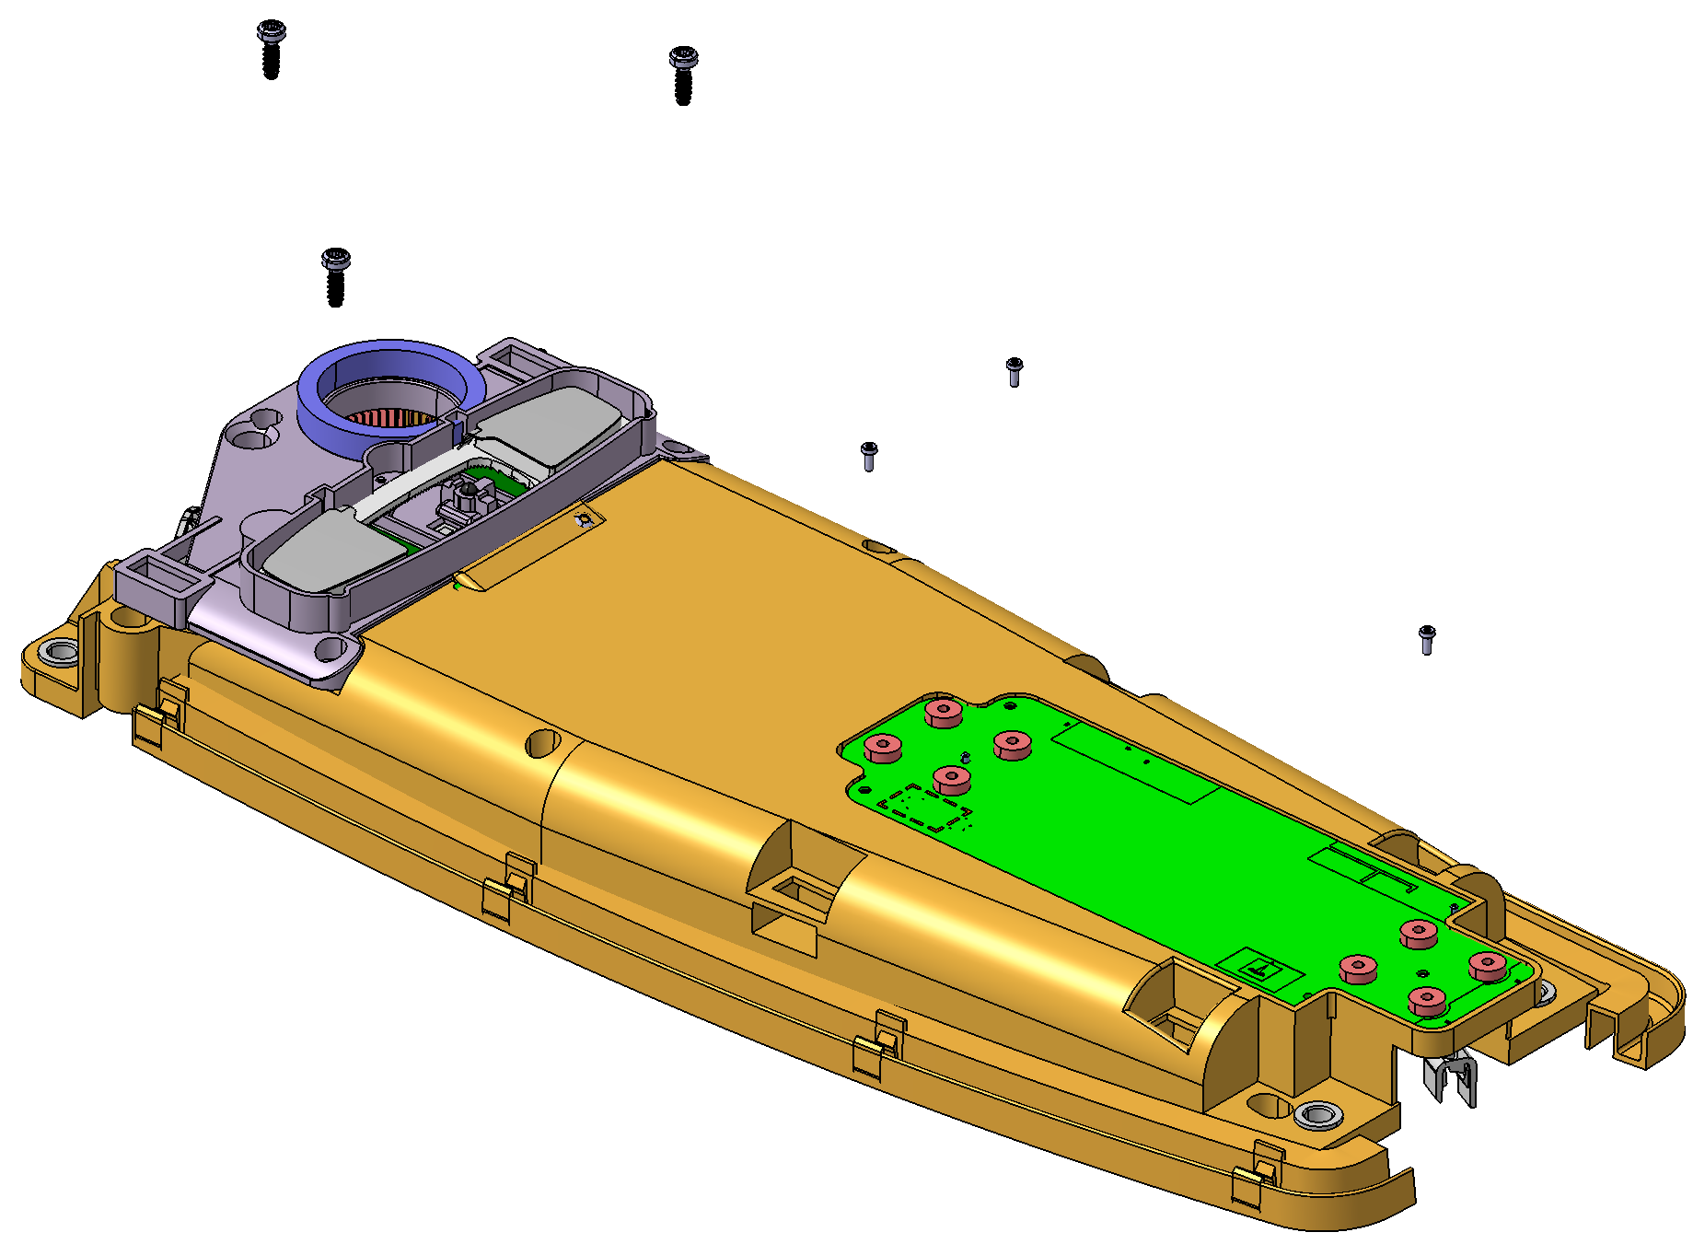
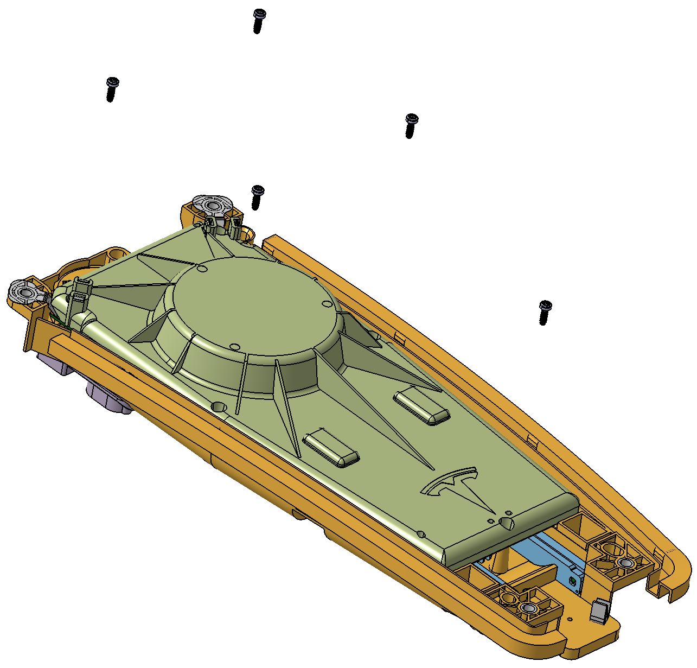
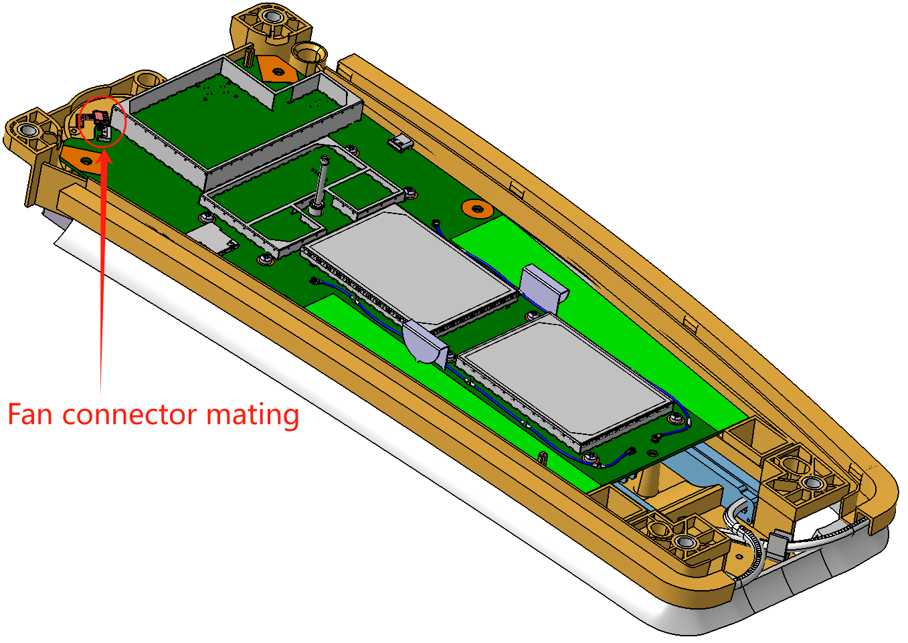
Process flow
5. TLA Product ASY
Mounting map-light module with Bottom enclosure ASY by 3X Screws;
Mounting Microphone Module with Bottom enclosure ASY by 3X Screws.
Flip over the Semi-product, and then mounting M354-10 Lighthouse front module-PCBA ASY with bottom enclosure ASY and then mounting the Rosenberger EBC connector Barrel with M354-10 Lighthouse front module-PCBA ASY. Mating the Fan wire connector & Board connector.
Mounting Lighthouse Top module ASY with Semi-product. Pay attention to the Rosenberger connector mating position. And then fixed the Lighthouse Top module ASY with semi-product by 5X Screw.

Slide 18
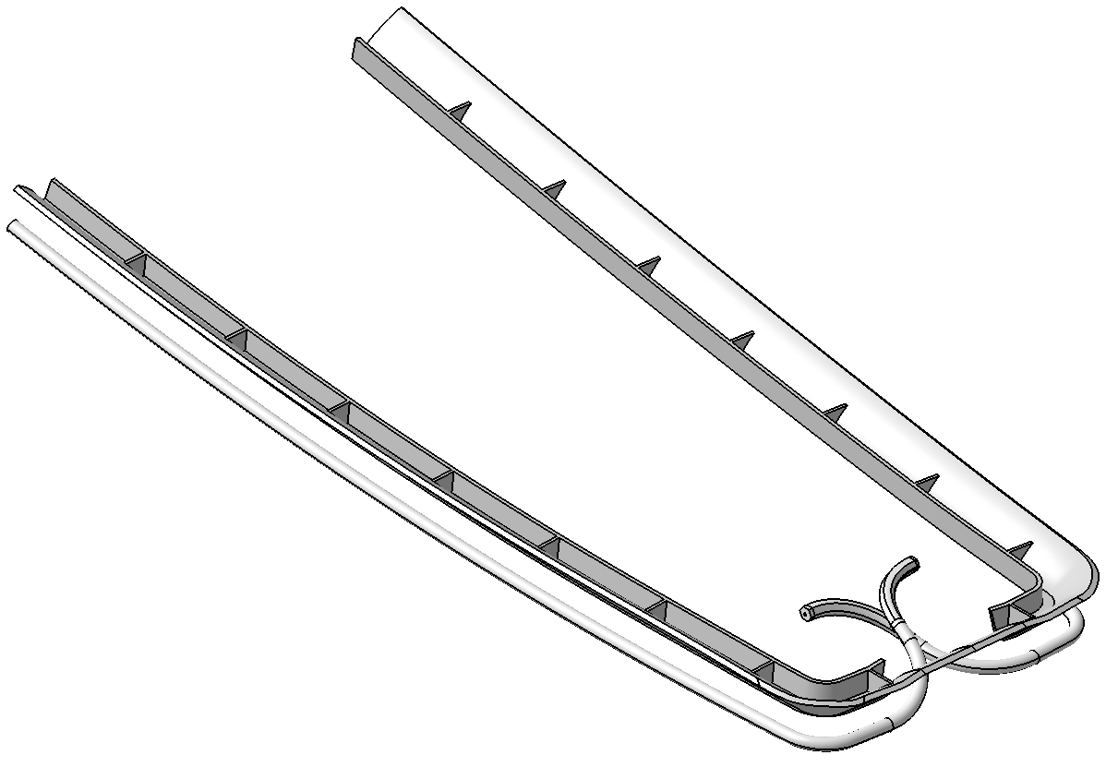
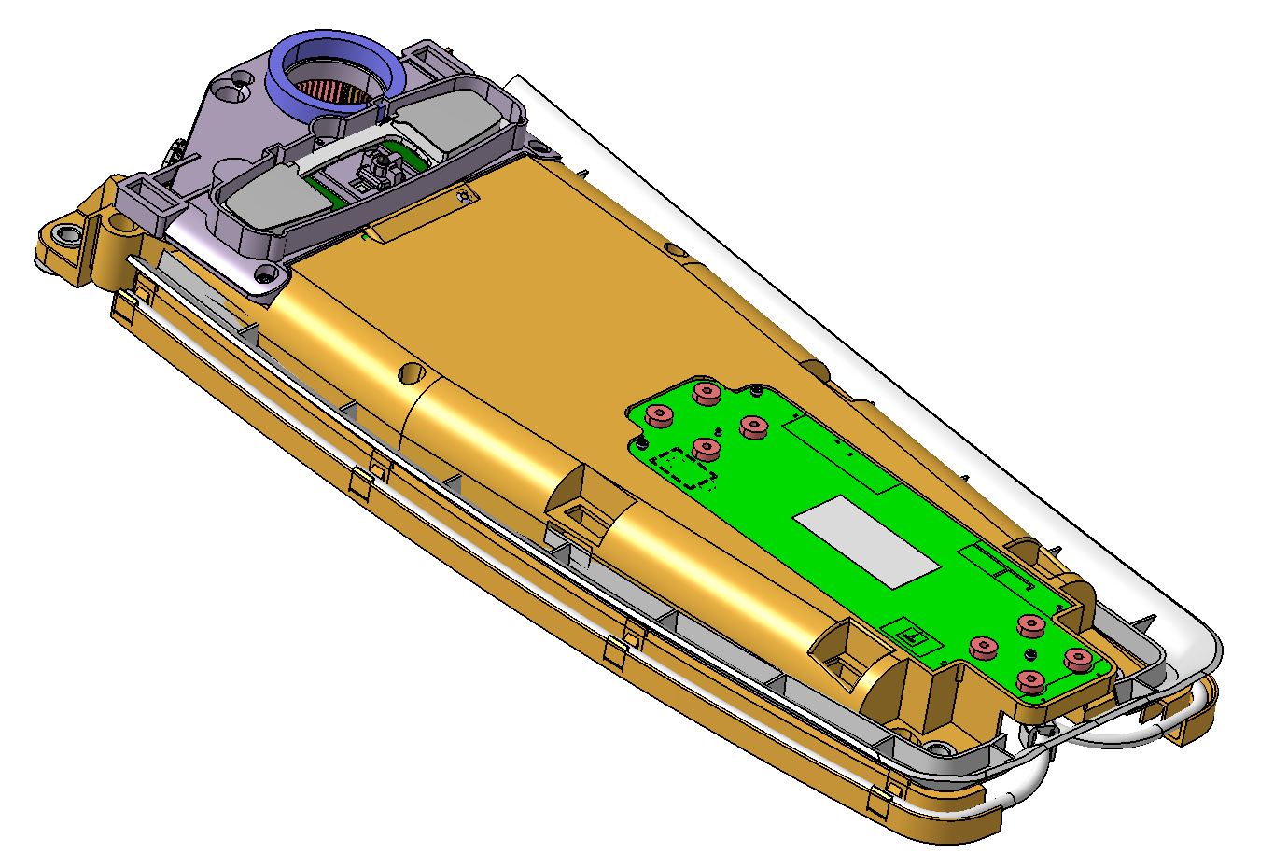
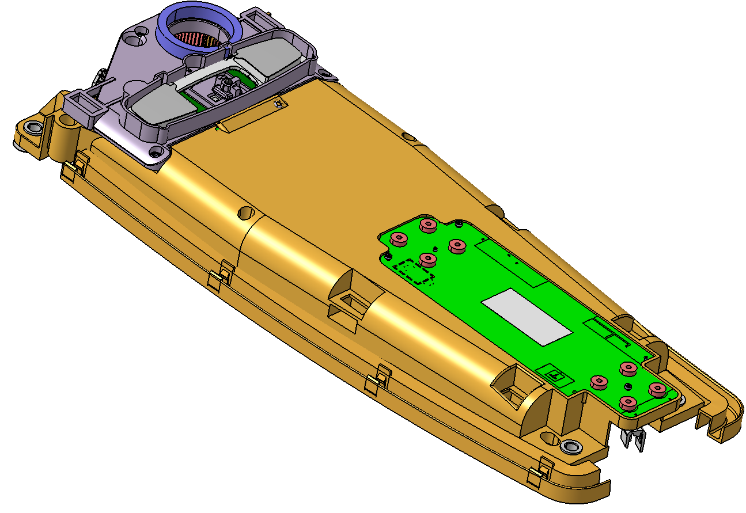
Process flow
6. TLA Product ASY
Mounting Right light pipe & Left light pipe & Light pipe carrier with Semi-product.
Pasting product label.
Do the test that listed below.
Continuity test;
Grounding check;
GNSS testing;
Cellular/Wi-Fi/BT testing;
Microphone testing;
Map light & Ambient lighting test;
Fan acoustic testing;
Passive entry BLE & UWB testing.

Slide 19
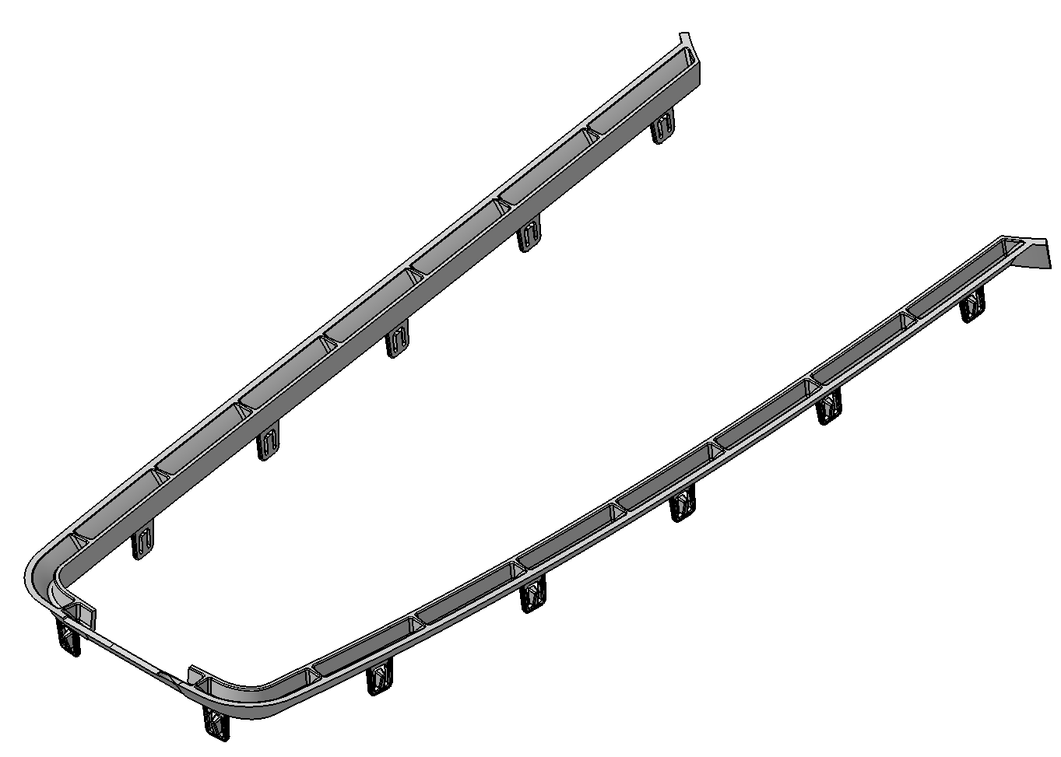
M354-01-Light pipe carrier
Change the 3d data
Material：Black PC, Covestro Makrolon 2805
Detail please refer to 3D drawing.
DFM.
Volume: Thailand
Volume 1: 2.5K/week*3years
Volume 2: 5K/week*3Years

Slide 20
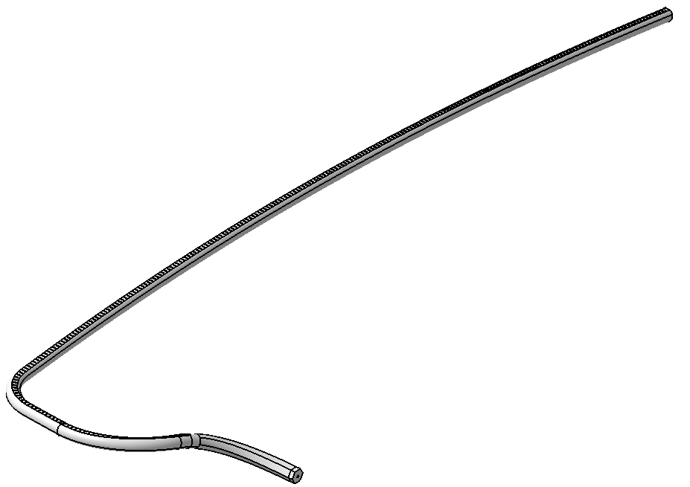
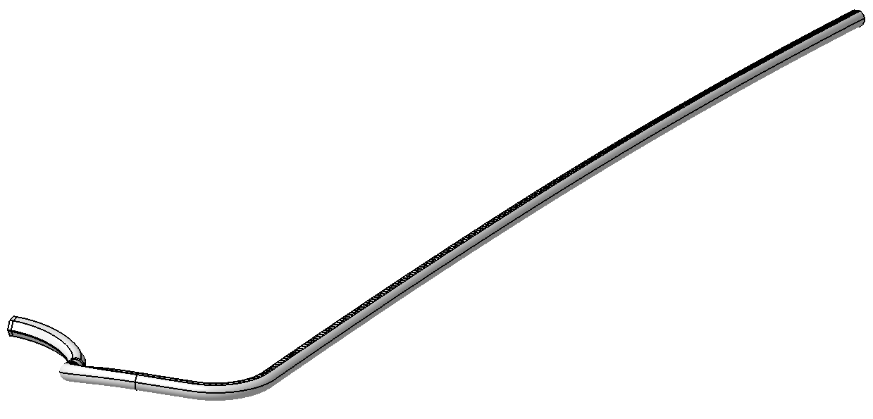
M354-02 & 03-Right & Left pipe carrier
M354-02 Right light pipe
M354-03 Left light pipe
Material：Transparent PC, Covestro Makrolon 2805
Detail please refer to 3D drawing.
DFM.
Volume: Thailand
Volume 1: 2.5K/week*3years
Volume 2: 5K/week*3Years

Slide 21
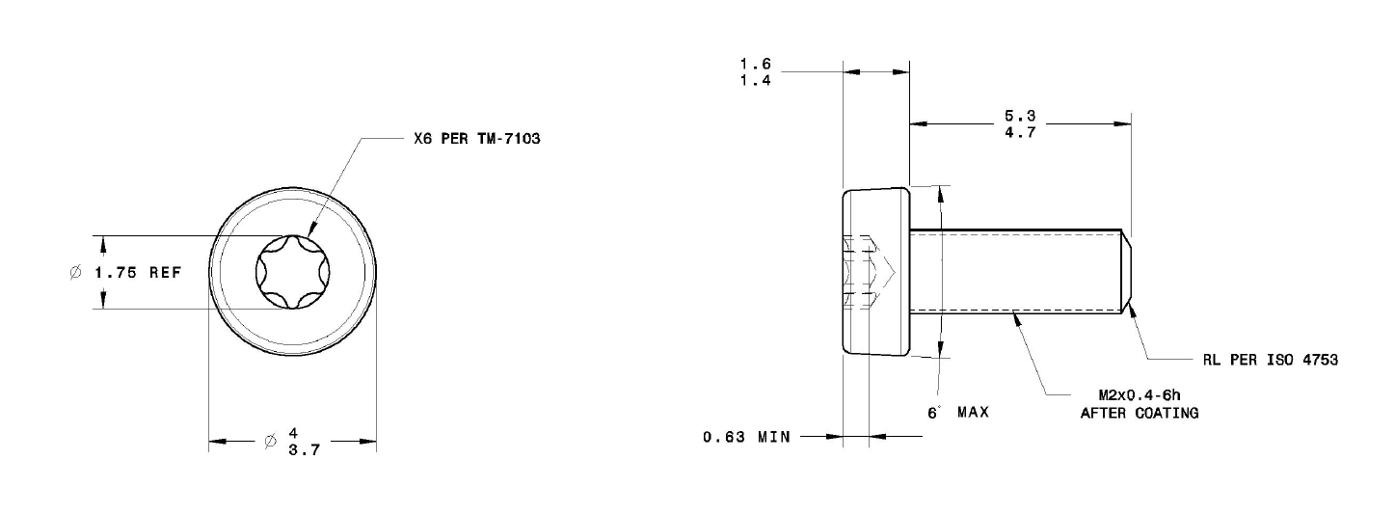
M354-05 Screw 1
Material：AISI 1022/SWCH 22A THRU hardened HRC 23~34；
Finished: Grade 01 per TM-0009F-M.
Volume: Thailand
Volume 1: 2.5K/week*3years
Volume 2: 5K/week*3Years

Slide 22
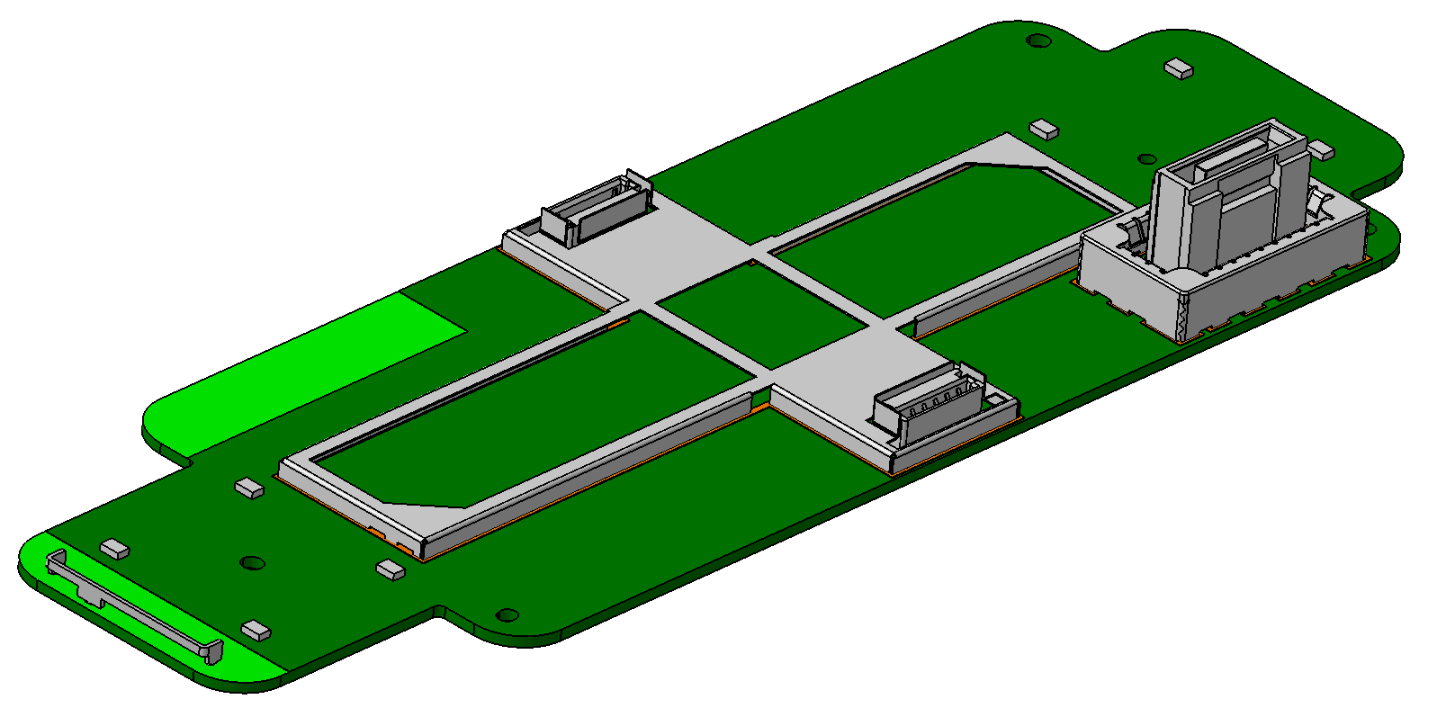
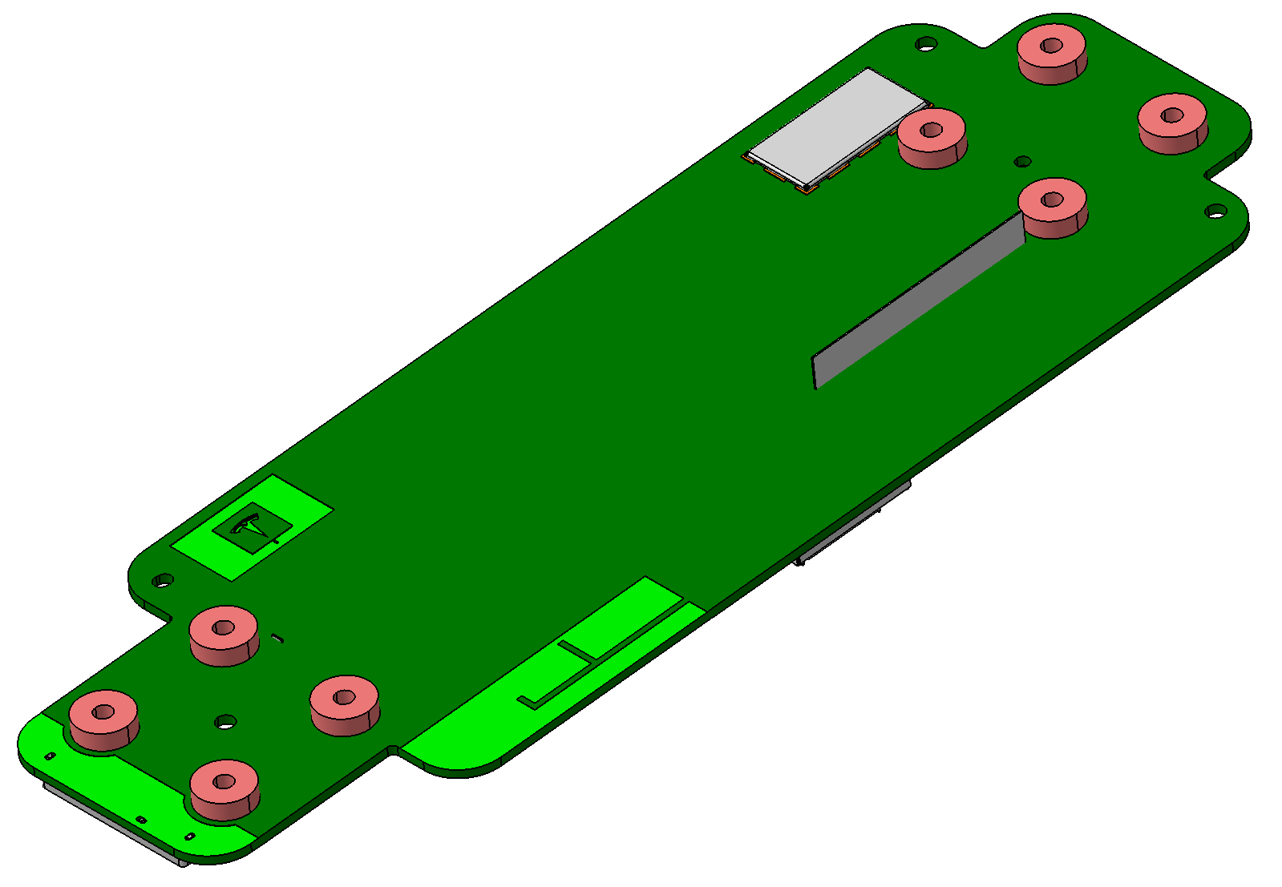
M354-06-02-Lighthouse microphones' PCBA
2 Side SMT
Volume: Thailand
Volume 1: 2.5K/week*3years
Volume 2: 5K/week*3Years

Slide 23
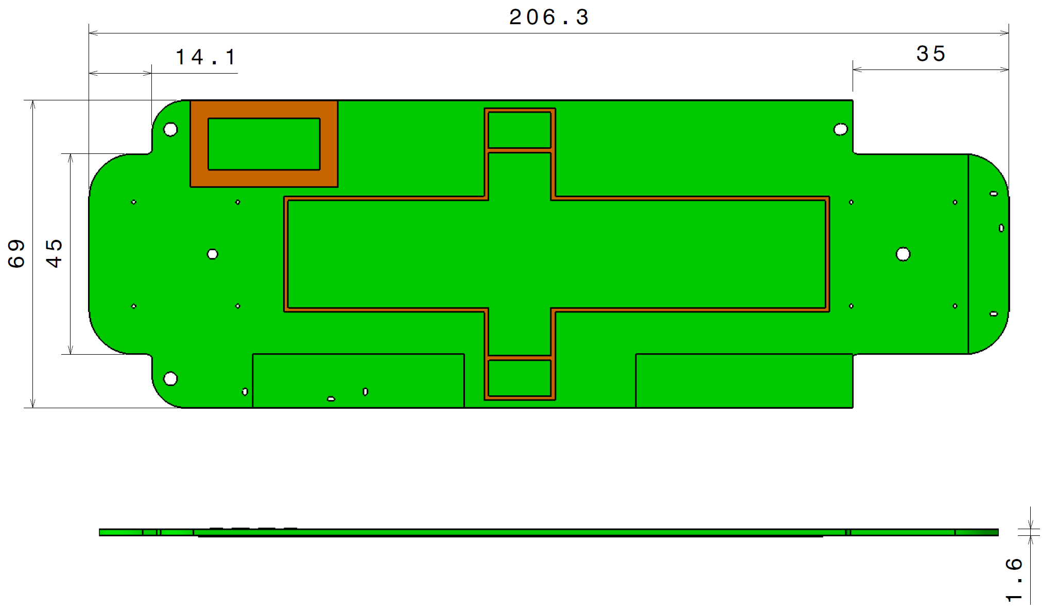
M354-06-02-01-Lighthouse microphones' PCB
Volume: Thailand
Volume 1: 2.5K/week*3years
Volume 2: 5K/week*3Years
层数：四层
材质：FR-4
成品铜厚：0.5Oz
是否含卤：无卤
成品板厚：1.6mm
连片方式：整版
表面处理方式：ENIG (IPC 4552 with 8w%~10w% P Minimum)
文字颜色：白色
防焊颜色：绿色

Slide 24
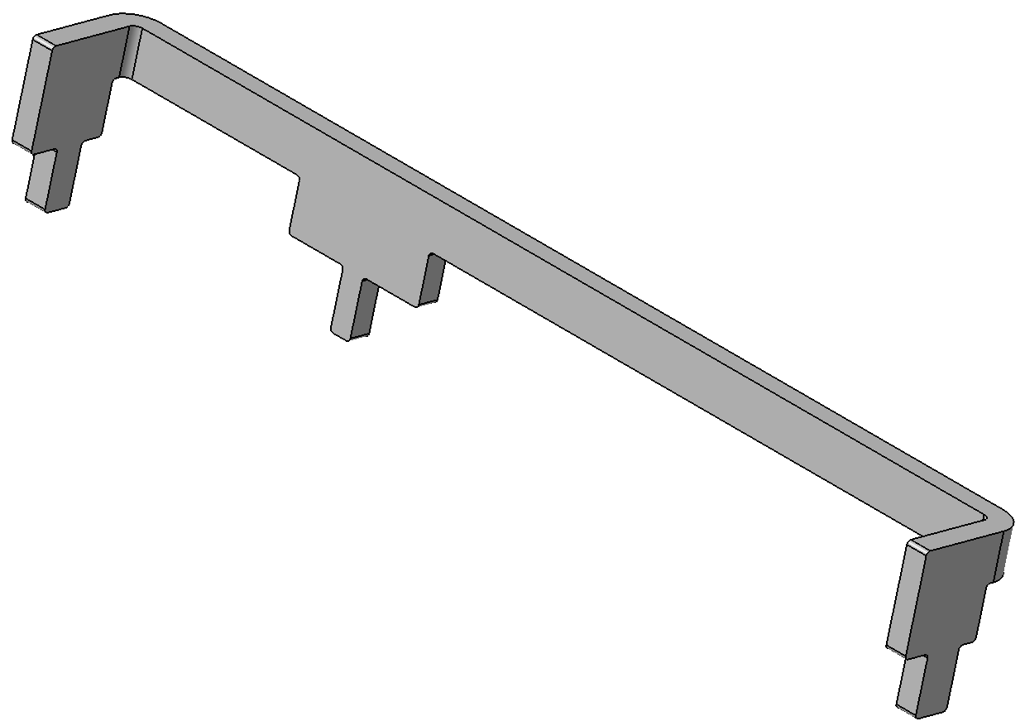
M354-06-02-02-BLE stamping antenna
Material & Treatment SPCC, 1/2H; T=0.6mm; Pre-Ni Plating 3-5um.
Detail please refer to 3D drawing.
DFM.
Volume: Thailand.
Volume 1: 2.5K/week*3years
Volume 2: 5K/week*3Years

Slide 25
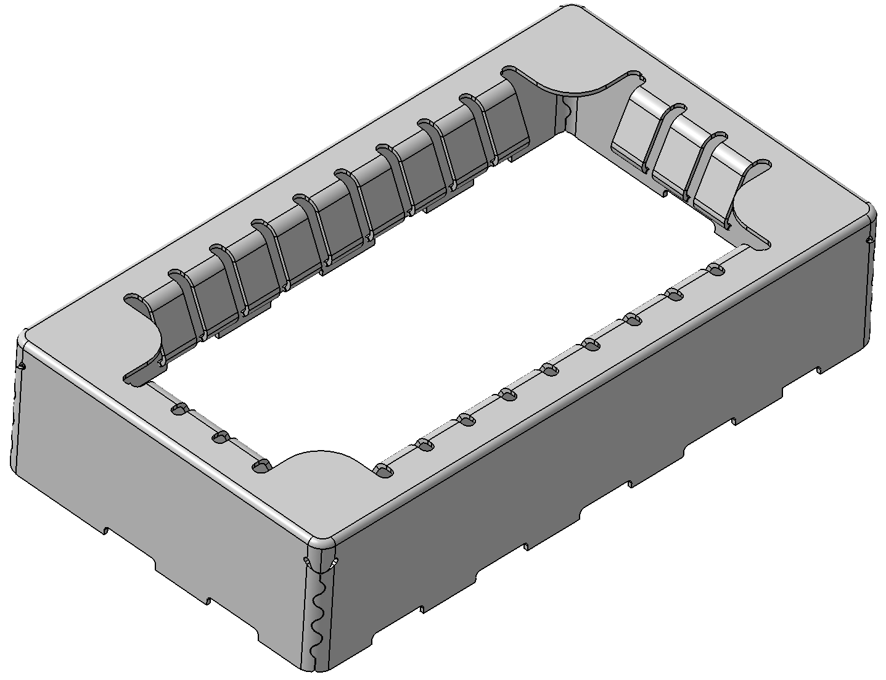
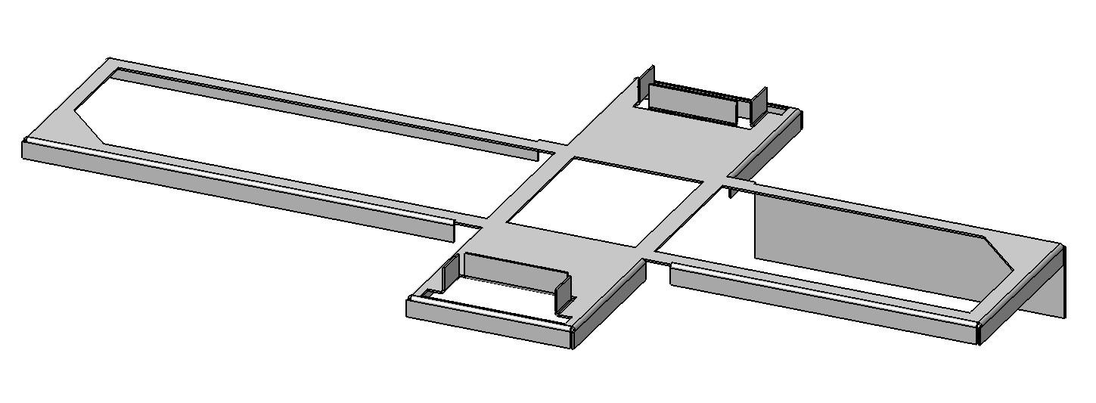


M354-06-02-03/04/05/06-Shield 1/2/3
Change the 3d data of shield 3
new
Material
Shield 1: Nickel Silver C7701, T=0.25mm; Shiled 2 & 3: Nickel Silver C7701, T=0.2mm.
Detail please refer to 3D drawing.
DFM.
Volume: Thailand.
Volume 1: 2.5K/week*3years
Volume 2: 5K/week*3Years

Slide 26
Connectors
08-0128X000
Hirose, FX23-40S-0.5SV10
M354-06-02-03
KYOCERA AVX: 009159004551906

Slide 27
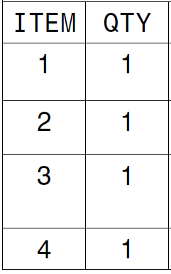
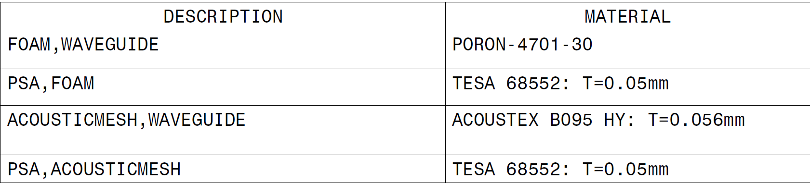
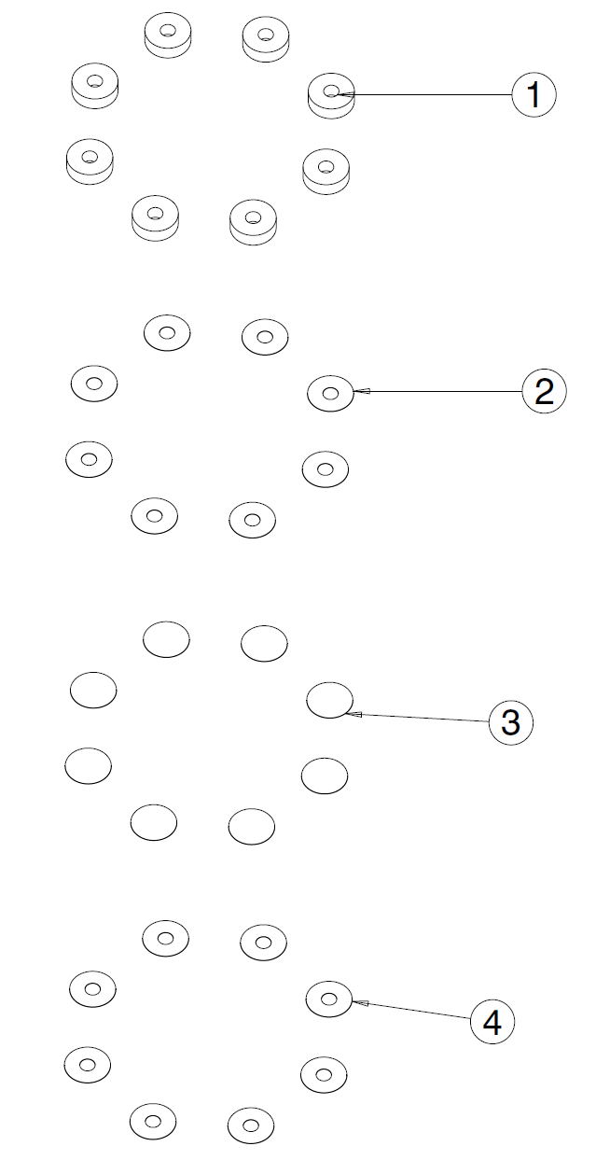
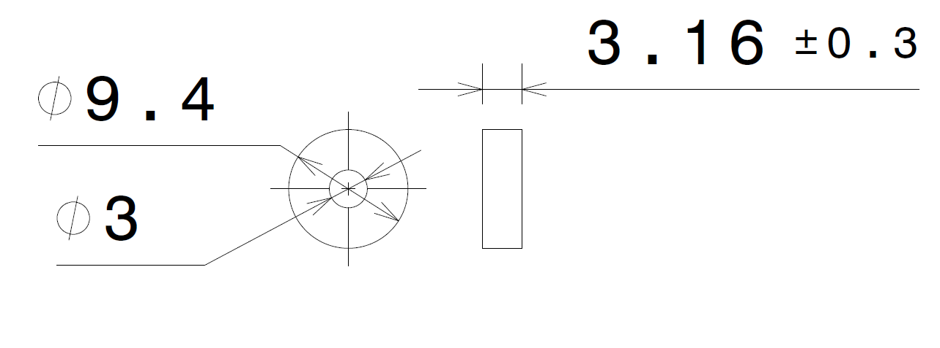
M354-06-04-Acoustic mesh
Volume: Thailand
Volume 1: 8X2.5K/week*3years
Volume 2: 8X5K/week*3Years

Slide 28


M354-08-01—Foam Seal, Inlet
Material: Rogers PORON 4790-15375-04 + 3M 9495LE
Volume: Thailand
Volume 1: 2.5K/week*3years
Volume 2: 5K/week*3Years

Slide 29


M354-08-02--Lighthouse map-light Housing-ASY
Customer confirmed that this module provided by another supplier.
Volume: Thailand
Volume 1: 2.5K/week*3years
Volume 2: 5K/week*3Years

Slide 30

M354-09-02--Bottom enclosure
Compression limiter
Metal insert: Brass, M2*3 Screw hole
Material & Treatment
Plastic cover: PC+ABS, Sabic Cycoloy C1200HF
Compression limiter: S10C (1008)， Zn-Ni plating, T=8~25μm, Nickel content 10~15%, 240h no white rust, 1000h no red rust.
Metal insert: Brass, with M2*3 Screw hole
Detail please refer to 3D drawing.
DFM.
Volume: Thailand
Volume 1: 2.5K/week*3years
Volume 2: 5K/week*3Years

Slide 31


M354-10-01 Screw for heatsink (ICR & TCU)
Material：Bolt C170 Per TM-0027M-F; Washer 420SS, Spring temper rockwell C45~ C50;
Finished: Passivated + finigard 105 with COEF 0.12~0.18.
Volume: Thailand
Volume 1: 2.5K/week*3years
Volume 2: 5K/week*3Years

Slide 32

M354-10-04--ICR heatsink
Material & Treatment GRADE 304-F-C-HP-ST-1 per TM-2006, SURFACE TREATMENT: SURTEC 650.
Detail please refer to 3D drawing.
DFM.
Volume: Thailand
Volume 1: 2.5K/week*3years
Volume 2: 5K/week*3Years

Slide 33

M354-10-05--Shield for RGB PCBA
Material: SUS 301, T=0.2mm;
Detail please refer to 3D drawing.
DFM.
Volume: Thailand
Volume 1: 2*2.5K/week*3years
Volume 2: 2*5K/week*3Years

Slide 34

M354-10-06--RGB PCBA
Customer confirmed this PCBA provided by another supplier.
Volume: Thailand
Volume 1: 2*2.5K/week*3years
Volume 2: 2*5K/week*3Years

Slide 35

M354-10-07--TCU heatsink
Material & Treatment GRADE 304-F-C-HP-ST-1 per TM-2006, SURFACE TREATMENT: SURTEC 650.
Detail please refer to 3D drawing.
DFM.
Volume: Thailand
Volume 1: 2.5K/week*3years
Volume 2: 5K/week*3Years

Slide 36


M354-10-08-Lighthouse front module PCBA
2 Side SMT
Volume:
Volume 1: 2.5K/week*3years
Volume 2: 5K/week*3Years

Slide 37



M354-10-08-PCB-Lighthouse front module PCB
EM-827, 329*145*1.6mm.
Finish: ENIG
BOW AND TWIST IS NOT TO EXCEED 0.5%.
PCB CLEANLINESS: SEE TABLE.
Volume:
Volume 1: 2.5K/week*3years
Volume 2: 5K/week*3Years
STACK UP

Slide 38
Connector For Lighthouse front module
08-0127X000
Hirose, FX23-40P-0.5SV15
08-0100X000
Rosenberger, EBCK111-40MN5
M354-10-08-01
Rosenberger, E6S20D-40MT5-Z
08-0124X000
Hirose, FX23-20S-0.5SV
M354-10-08-02
Samtec, TSM-105-02-L-DV
08-0098X000
Molex, 87898-0304
08-0125X000
Molex, 1054500101

Slide 39







Shield frame & Shield cover For Lighthouse front module
Material: Nickel Silver C7701
Detail please refer to 3D drawing.
DFM.
Volume: Thailand.
Volume 1: 2.5K/week*3years
Volume 2: 5K/week*3Years

Slide 40

M354-10-08-08- WiFi Stamping antenna
Material & Treatment SPCC, 1/2H; T=0.4mm; Pre-Ni Plating 3-5um.
Detail please refer to 3D drawing.
DFM.
Volume: Thailand.
Volume 1: 2.5K/week*3years
Volume 2: 5K/week*3Years

Slide 41

M354-10-10- Micro-coax cable
Volume: Thailand.
Volume 1: 2*2.5K/week*3years
Volume 2: 2*5K/week*3Years

Slide 42

M354-10-11- ICR Connector
Press fit pin
housing
Material & Treatment Plastic: PBT, press-fit pin: CuSn560, Tin plating 1~2.5μm after Ni plating 1~3μm.
Detail please refer to 3D drawing.
DFM.
Volume: Thailand
Volume 1: 2.5K/week*3years
Volume 2: 5K/week*3Years

Slide 43
M354-11-Rosenberger EBC connector Barrel
Volume: Thailand
Volume 1: 2.5K/week*3years
Volume 2: 5K/week*3Years

Slide 44

M354-12-01-Grounding Sheetmetal
Material & Treatment CR3-140-270-S-GI60/60-E, Zn Plating.
Detail please refer to 3D drawing.
DFM.
Volume: Thailand.
Volume 1: 2*2.5K/week*3years
Volume 2: 2*5K/week*3Years

Slide 45

M354-12-02-GNSS PCBA
1 Side SMT
Volume: Thailand
Volume 1: 2.5K/week*3years
Volume 2: 5K/week*3Years

Slide 46

M354-12-02-01-Lighthouse microphones' PCB
Volume: Thailand
Volume 1: 2.5K/week*3years
Volume 2: 5K/week*3Years
Ø100*1.4mm
层数：两层
材质：FR-4
成品铜厚：0.5Oz
是否含卤：无卤
成品板厚：1.4mm
连片方式：整版
表面处理方式：ENIG (IPC 4552 with 8w%~10w% P Minimum)
文字颜色：白色
防焊颜色：绿色

Slide 47
M354-12-02-02-Rosenberger EBC connector
Volume: Thailand
Volume 1: 2.5K/week*3years
Volume 2: 5K/week*3Years

Slide 48

M354-12-03 Top Enclosure
Metal insert: Brass, M2*3 Screw hole
Material & Treatment
PC+ABS, Sabic Cycoloy C1200HF
Insert mold: Brass, M2*3 Screw hole
Detail please refer to 3D drawing.
DFM.
Volume: Thailand
Volume 1: 2.5K/week*3years
Volume 2: 5K/week*3Years

Slide 49
Packaging—Initial BOM
Part no. | Part name | Material/Spec./Size. | Unit | Usage
 | Carton box | Outsize：960*560*240mm，corrugated paper(T=7mm) | PLT | 0.125
 | Paper board | Outsize：940*540*7mm，corrugated paper(T=7mm) | PLT | 0.125
 | EPE TRAY | Outsize：940*540*97mm. corrugated paper(T=7mm)+EPE(ESD 25kg/m^3) | PLT | 0.25
 | EPE | Outsize：940*50*20mm. EPE(ESD 20kg/m^3) | PLT | 0.25
 | PE ESD bag | 750*600mm, LDPE (T=0.06mm) LDPE ESD | PLT | 1
P15-01 | Desiccant | P15-01 | PLT | 1

Slide 50

Packaging

Slide 51

Packaging--Pallet

Slide 52
Thanks a lot!

